Slide 1
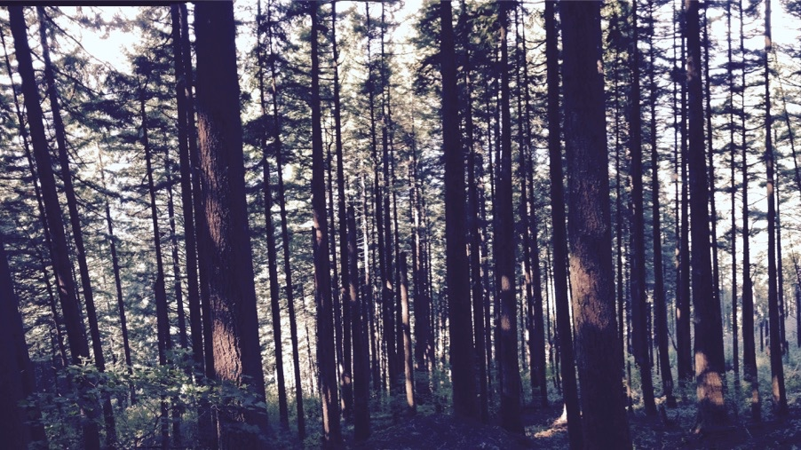
Plants aren’t dumb Using optimality theory to understand big questions in plant ecophysiology
Nick Smith
Department of Biological Sciences
Texas Tech University
nick.smith@ttu.edu

Slide 2
Why do people care about plants?

Slide 3
Why do people care about plants?

Slide 4
Why do people care about plants?

Slide 5
Why do people care about plants?

Slide 6
Why do people care about plants?

Slide 7
Why do people care about plants?

Slide 8
Why do people care about plants?

Slide 9
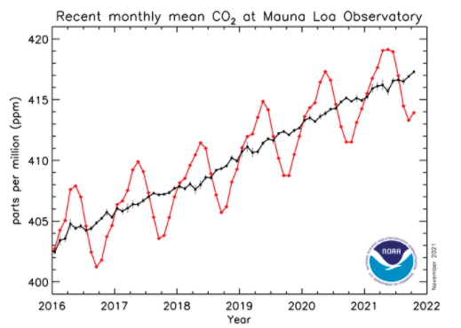
Why do people care about plants?

Slide 10
In other words: plants provide ecosystem services
FNAL

Slide 11
Including photosynthesis
FNAL

Slide 12
Photosynthesis provides the foundation for other services
FNAL

Slide 13
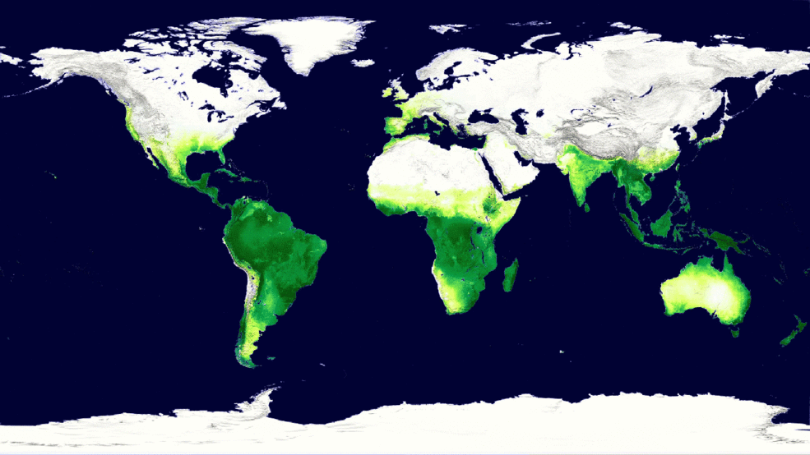
Photosynthesis is a dynamic process that is likely to be impacted by global change
MODIS, NASA

Slide 14
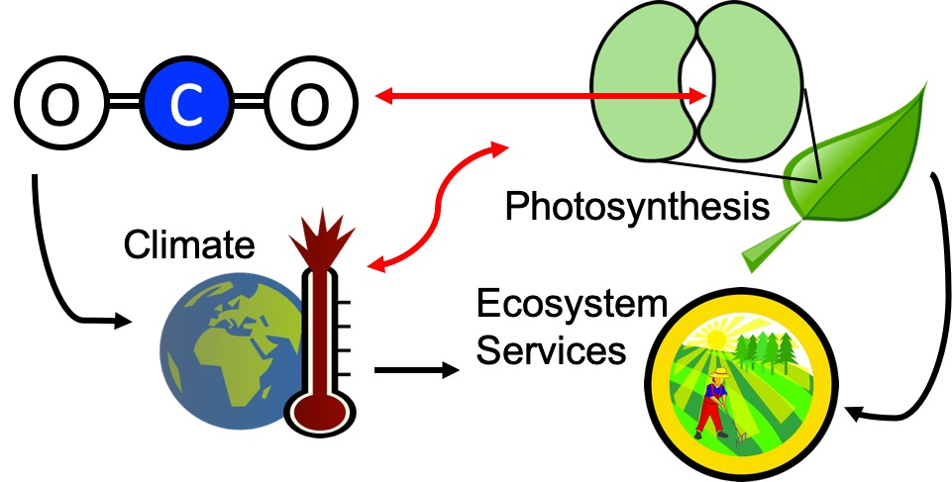
Our lab examines photosynthesis as a regulator of global change impacts on ecosystem services

Slide 15
Photosynthesis is important! An example…

Slide 16
Photosynthesis is important! An example…
Data from IPCC (2013)

Slide 17
Photosynthesis is important! An example…
Photosynthesis
Data from IPCC (2013)

Slide 18
Photosynthesis is important! An example…
Photosynthesis
A small percentage change in photosynthesis can have large consequences for climate
Data from IPCC (2013)

Slide 19
But predictions are uncertain!
Friedlingstein et al. (2014)

Slide 20
But predictions are uncertain!
Future model uncertainty (14 Pg) > current fossil fuel emissions (9.5 Pg)
Friedlingstein et al. (2014)

Slide 21
This uncertainty is driven by uncertainty in photosynthesis
Friedlingstein et al. (2014)
Keenan et al. (in prep)

Slide 22
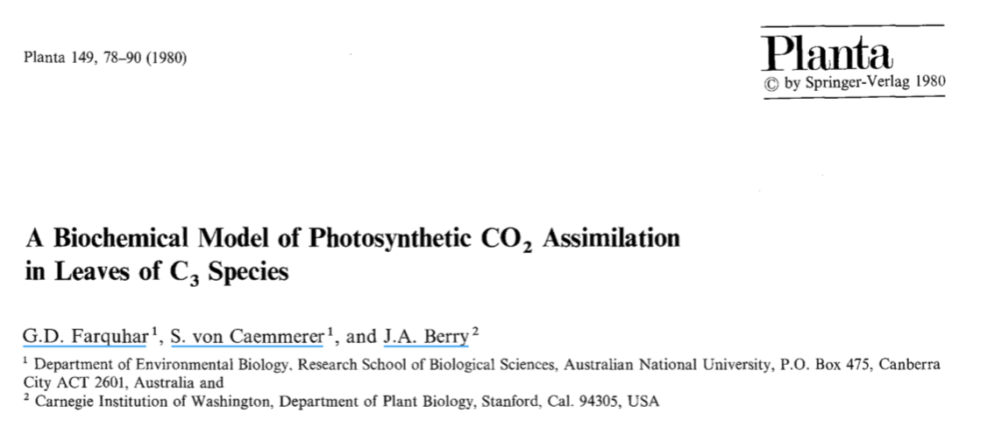
Why the uncertainty? Theoretical models for photosynthesis exist

Slide 23
These produce short term responses that match data

Slide 24
Why the uncertainty? Long-term responses differ from short-term responses due to acclimation

Slide 25
Dumb plants

Slide 26
Acclimated to high light
Acclimated to low light

Slide 27
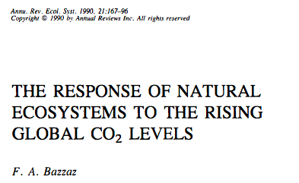
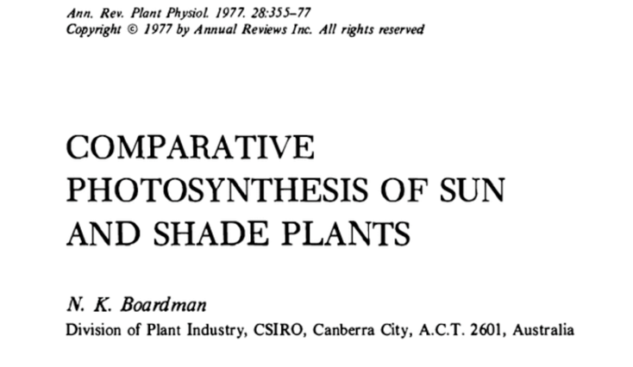
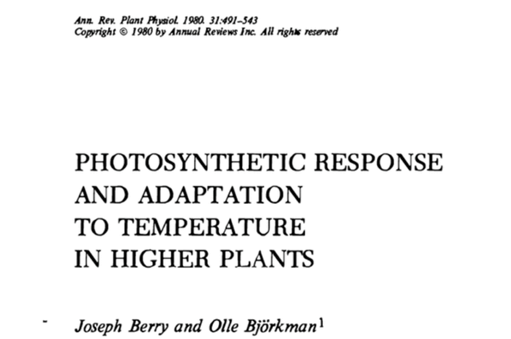
Acclimation is ubiquitous and well known…
Temperature: Berry & Björkman (1980)
CO₂: Bazzaz (1990)
Light: Boardman (1977)

Slide 28
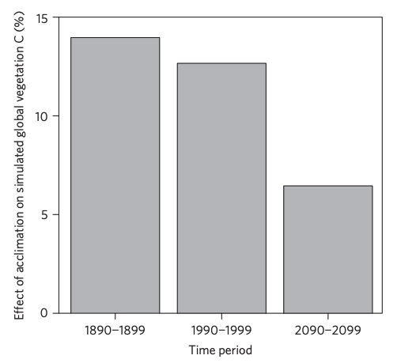
…and can impact carbon cycling and climate
Acclimation increase future C storage by ~6%
Acclimation alters future temperature by >1°C
Smith et al. (2017) Nature Climate Change
Smith et al. (2017) JAMES

Slide 29
Unfortunately, no theoretical model for photosynthetic acclimation exists

Slide 30
Lack of theory results in…

Slide 31
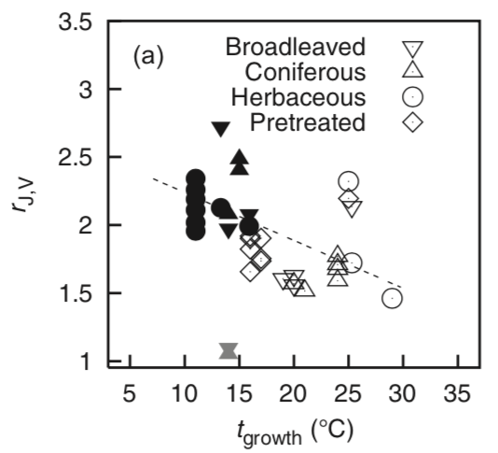
Lack of theory results in…
Unreliable future predictions (overparameterization, tuning)
Reliance on statistical models
Resulting change in simulated photosynthesis
Physiological parameter
Environmental condition
Kattge and Knorr (2007) PC&E
Smith et al. (2017) JAMES

Slide 32
Lack of theory results in…
Inability to test mechanisms
Resulting change in simulated photosynthesis
Physiological parameter
Environmental condition
Kattge and Knorr (2007) PC&E
Smith et al. (2017) JAMES

Slide 33
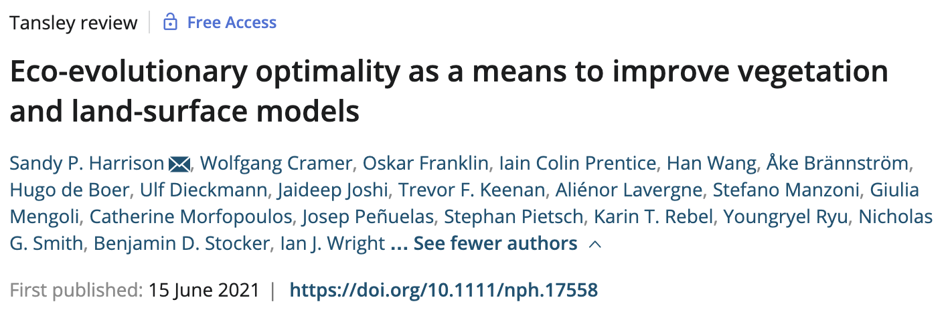
So, we developed a mechanistic model of photosynthetic acclimation Based on optimization and the first principles of plant physiological theory
Harrison et al. (2021)

Slide 34
Optimization: Least cost theory
Optimally, plants will maintain fastest rate of photosynthesis at the lowest summed resource cost (water and nutrient use)
Wright et al. (2003)

Slide 35
Optimal photosynthesis
Photosynthesis = f{stomatal conductance,
photosynthetic biochemistry}

Slide 36
Optimal photosynthesis
Photosynthesis = f{stomatal conductance,
photosynthetic biochemistry}
Must predict optimal rates of both

Slide 37
Optimal photosynthesis
Photosynthesis = f{stomatal conductance,
photosynthetic biochemistry}
[TALK TO ME LATER ABOUT THIS IF YOU ARE INTERESTED]
Prentice et al. (2014); Wang et al. (2017); Smith et al. (2019)

Slide 38
Optimal photosynthesis
Photosynthesis = f{stomatal conductance,
photosynthetic biochemistry}

Slide 39
Biochemistry optimization
Plant biochemistry setup will aim for equal limitation by all factors
[TALK TO ME LATER ABOUT THE MATHS]

Slide 40
Biochemistry trait The maximum rate of Rubisco carboxylation (V_{cmax})

Slide 41
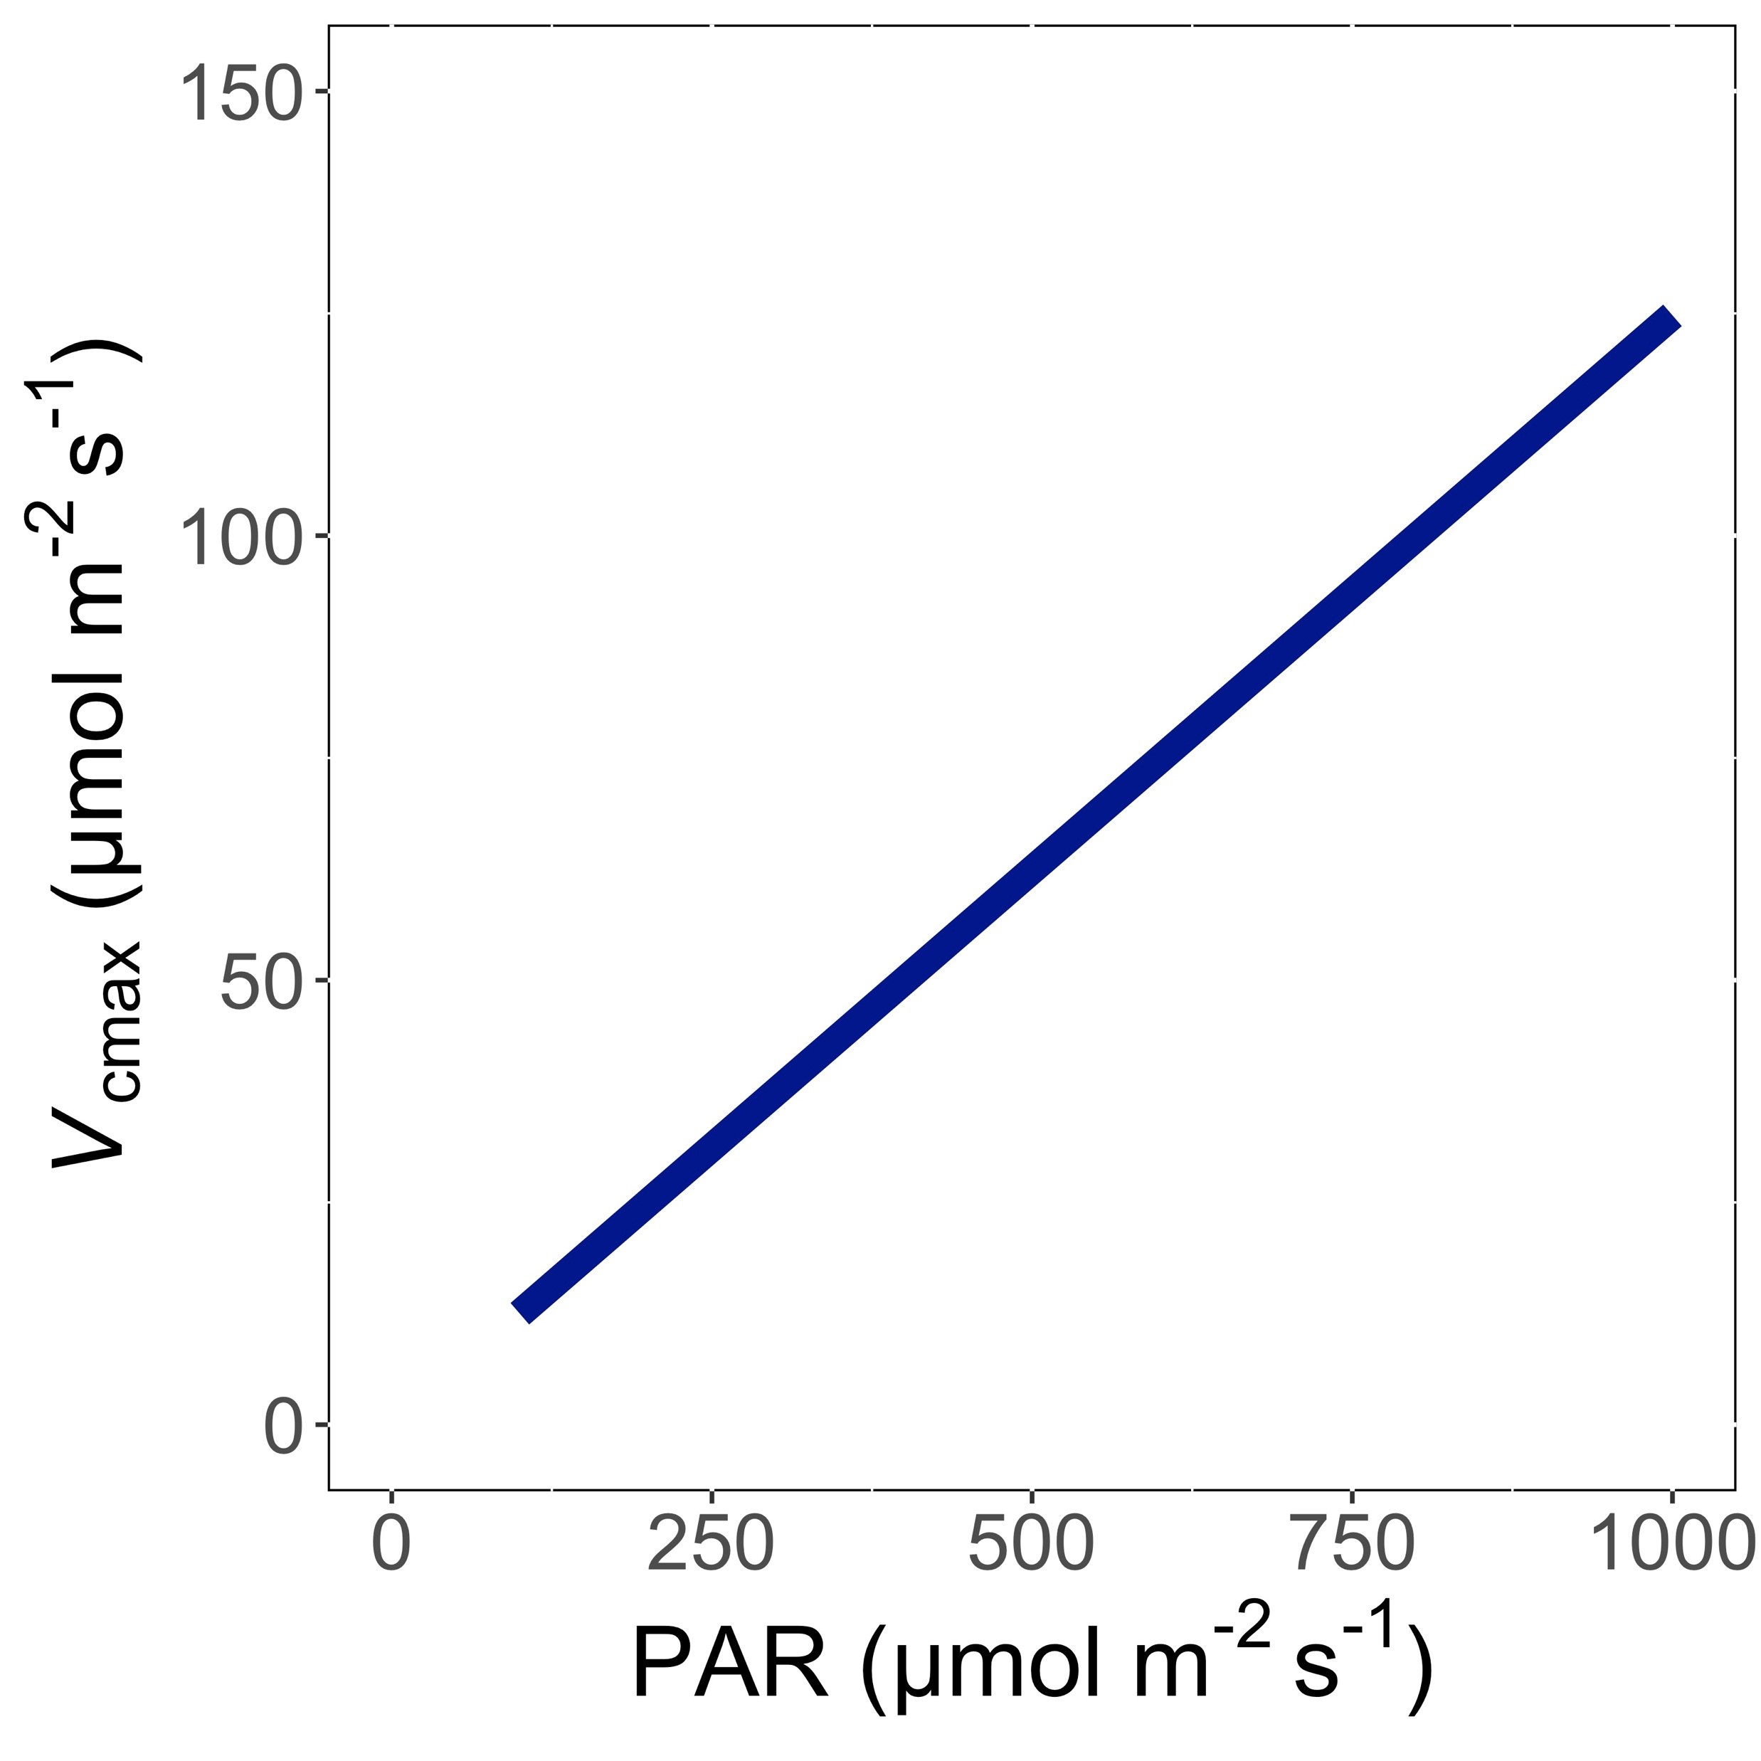
V_{cmax} increases with light because of greater electron transport
Smith et al. (2019); Smith and Keenan (2020)

Slide 42
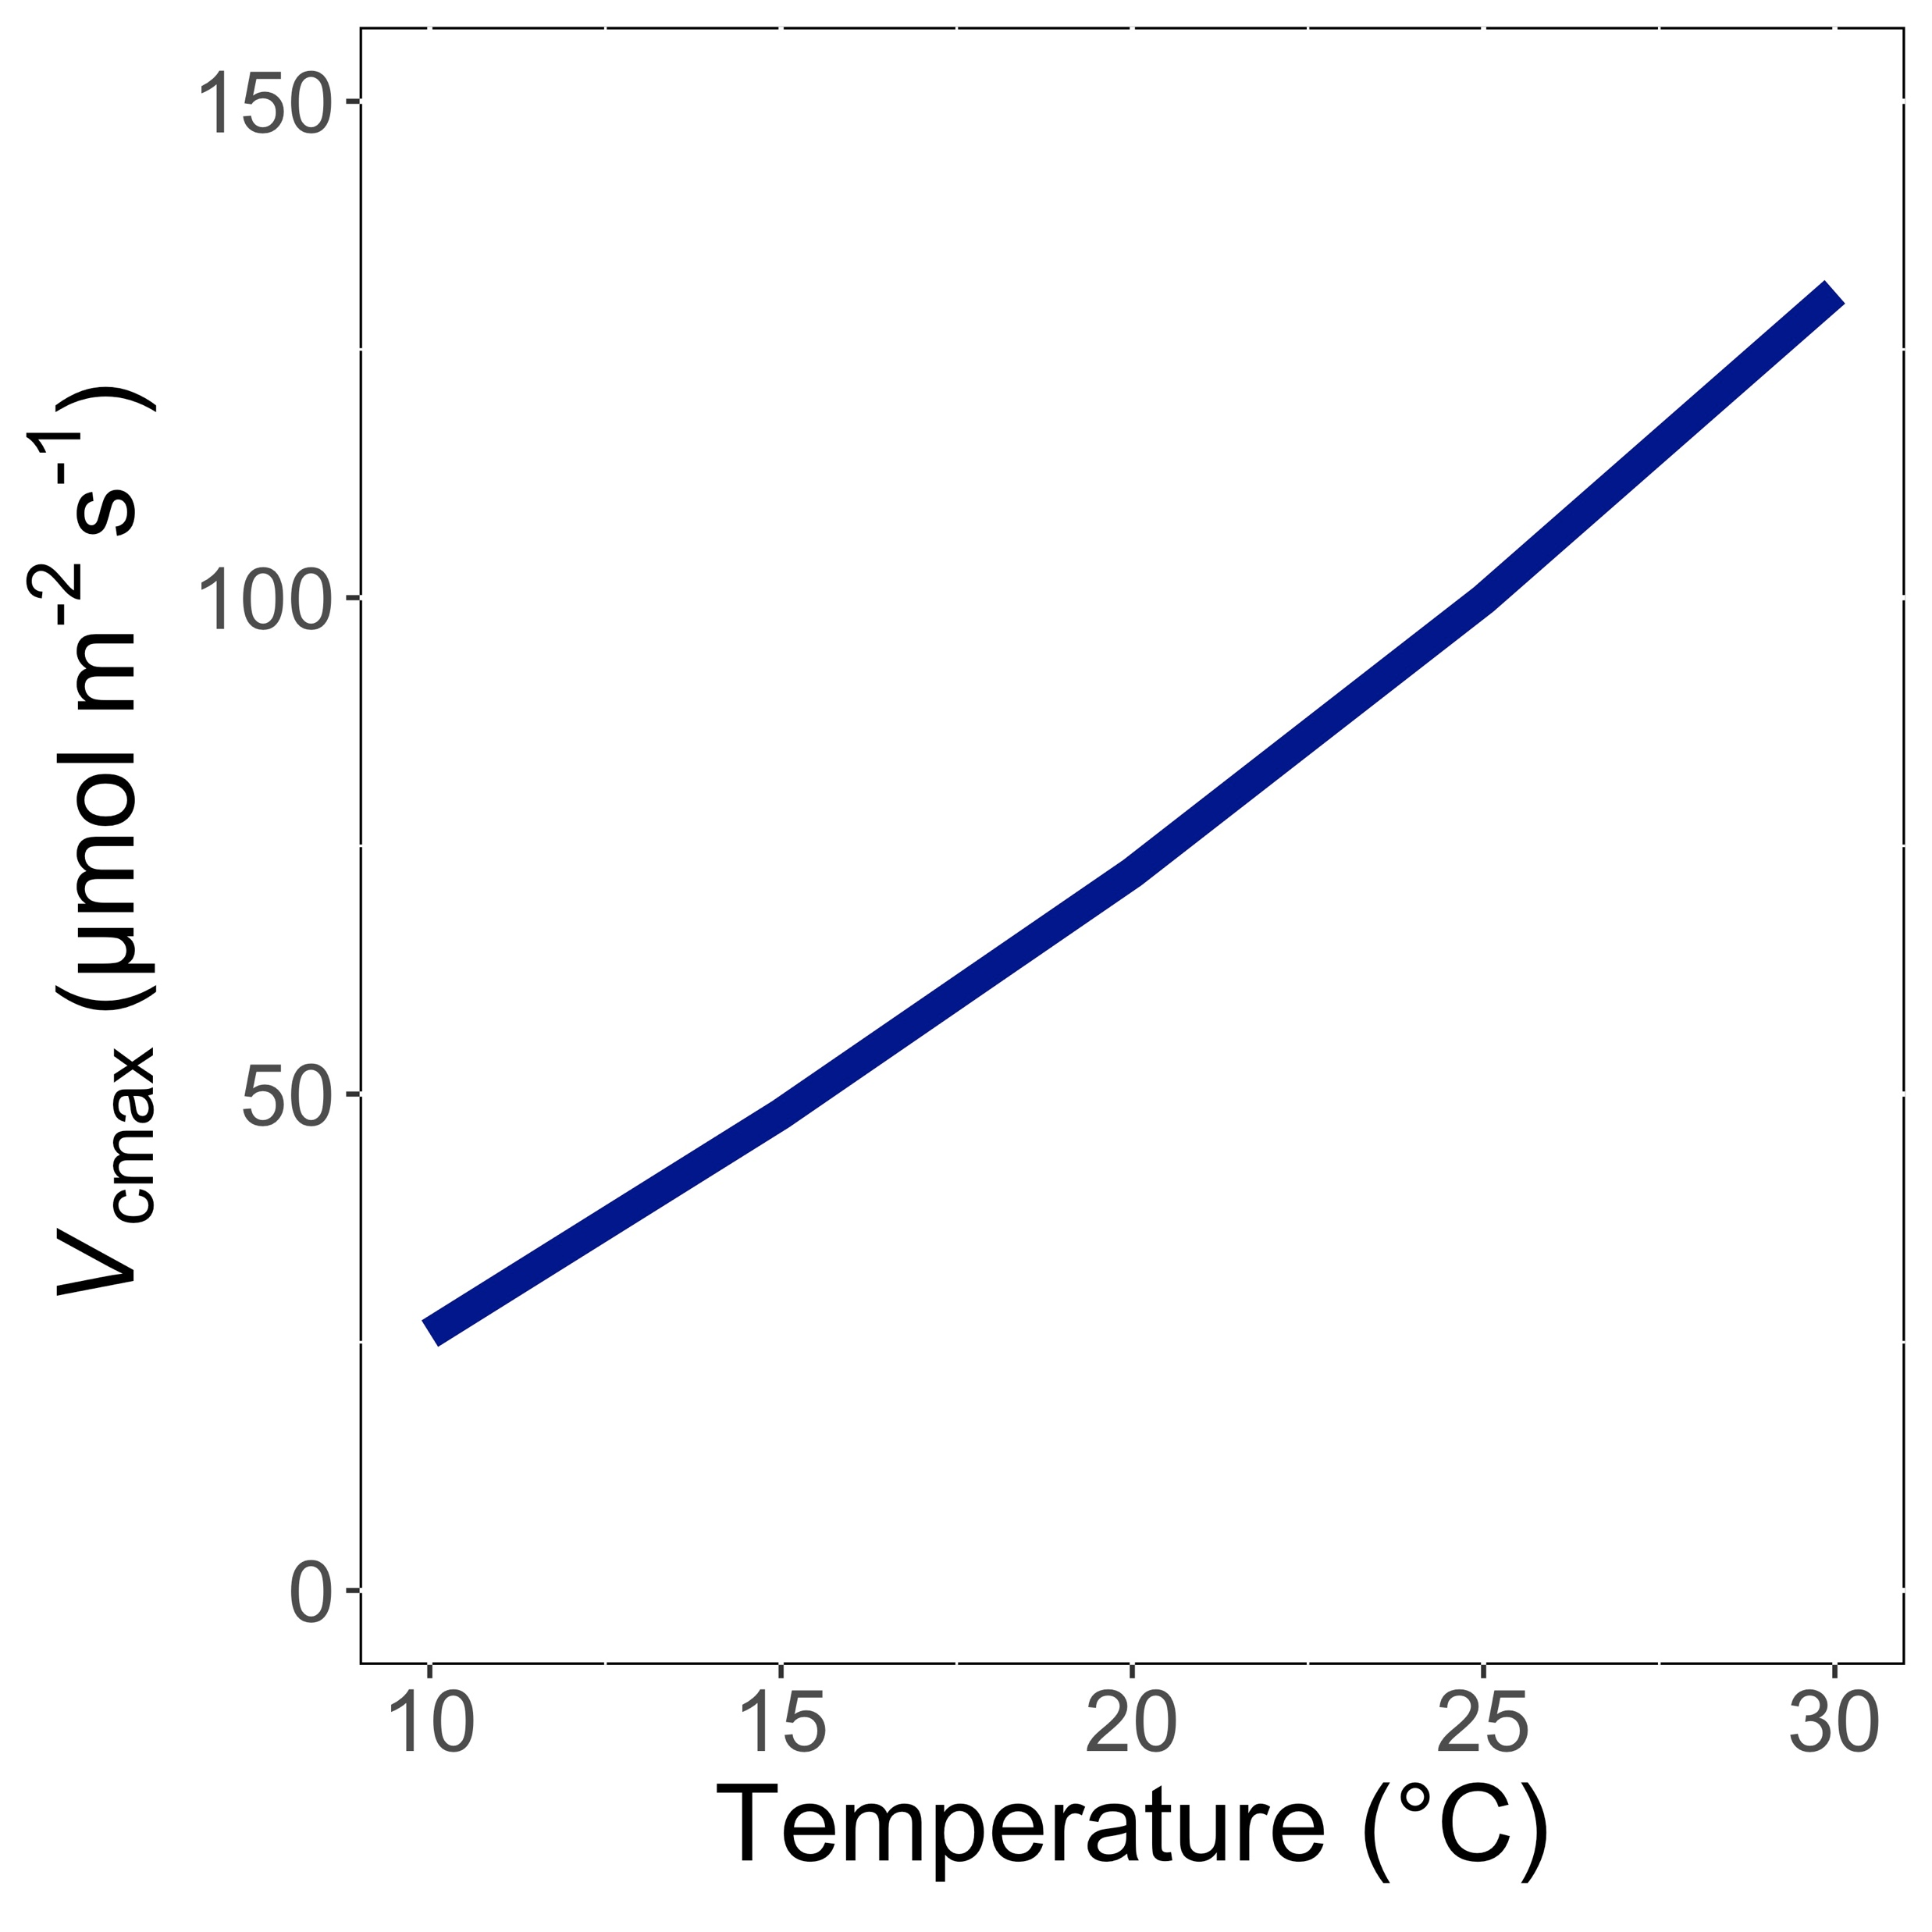
V_{cmax} increases with temperature because of greater electron transport and photorespiration
Smith et al. (2019); Smith and Keenan (2020)

Slide 43
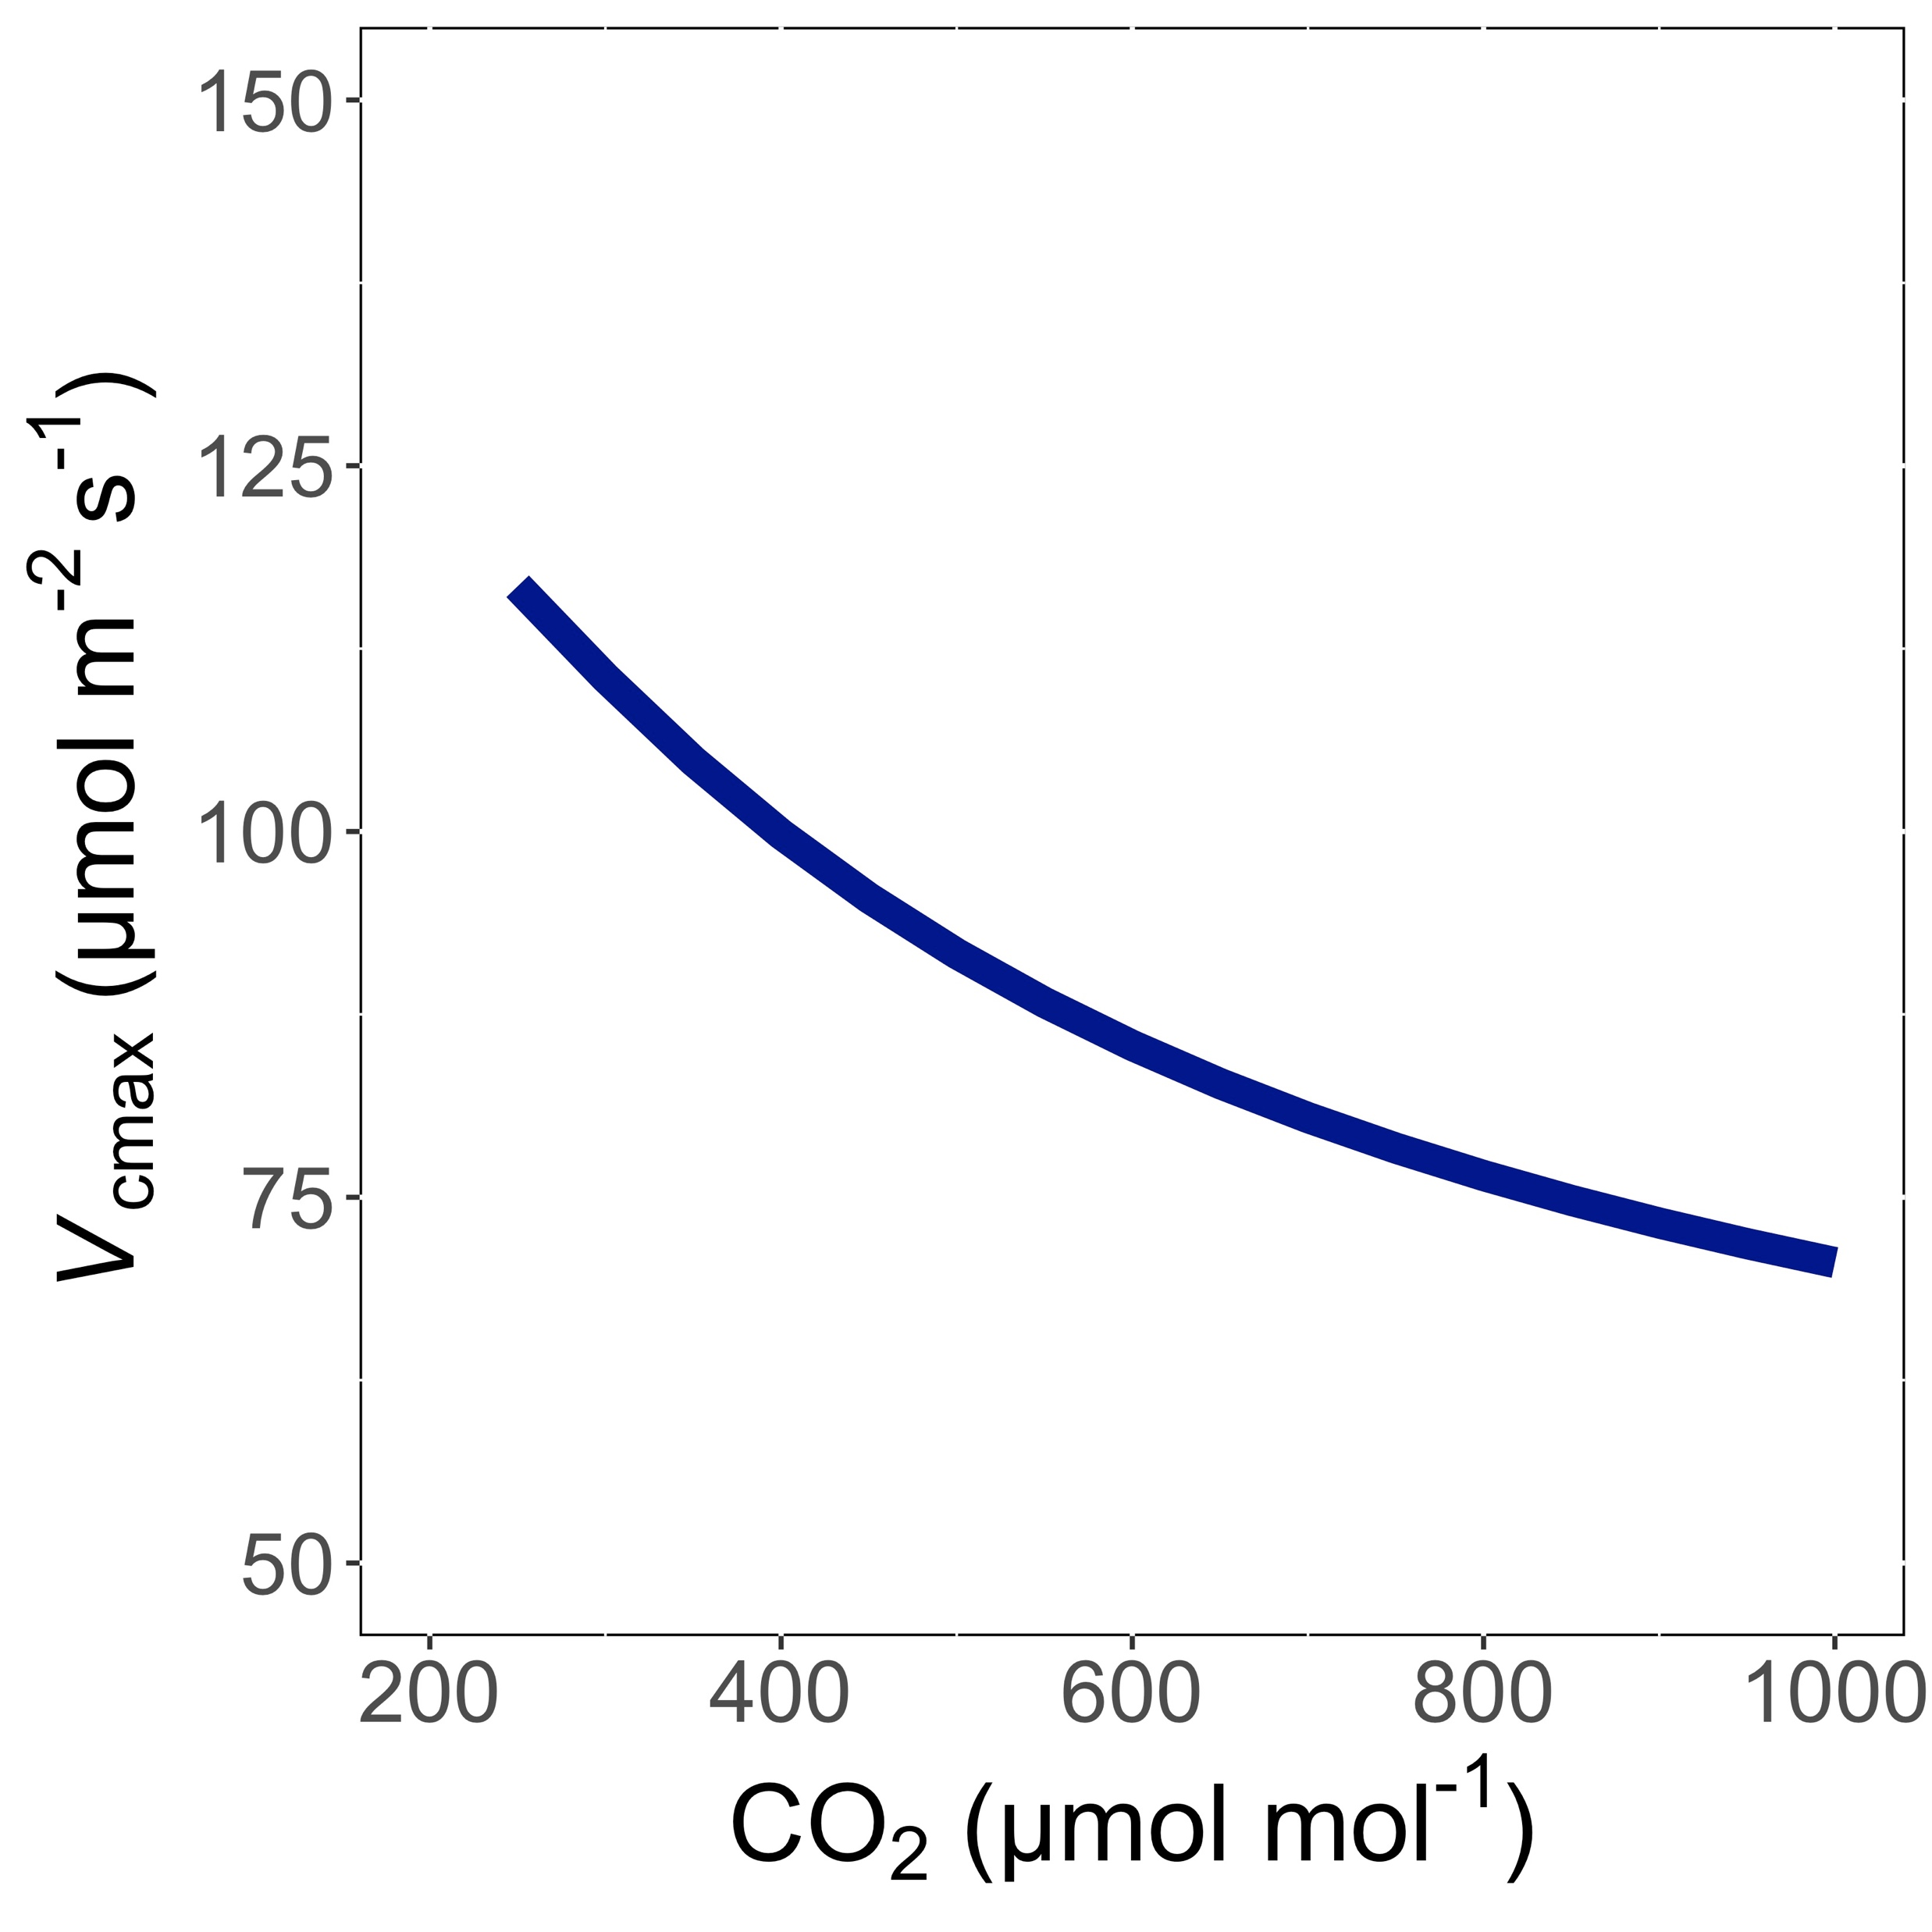
V_{cmax} decreases with CO₂ because of greater CO₂ in the leaf and less photorespiration
Smith et al. (2019); Smith and Keenan (2020)

Slide 44
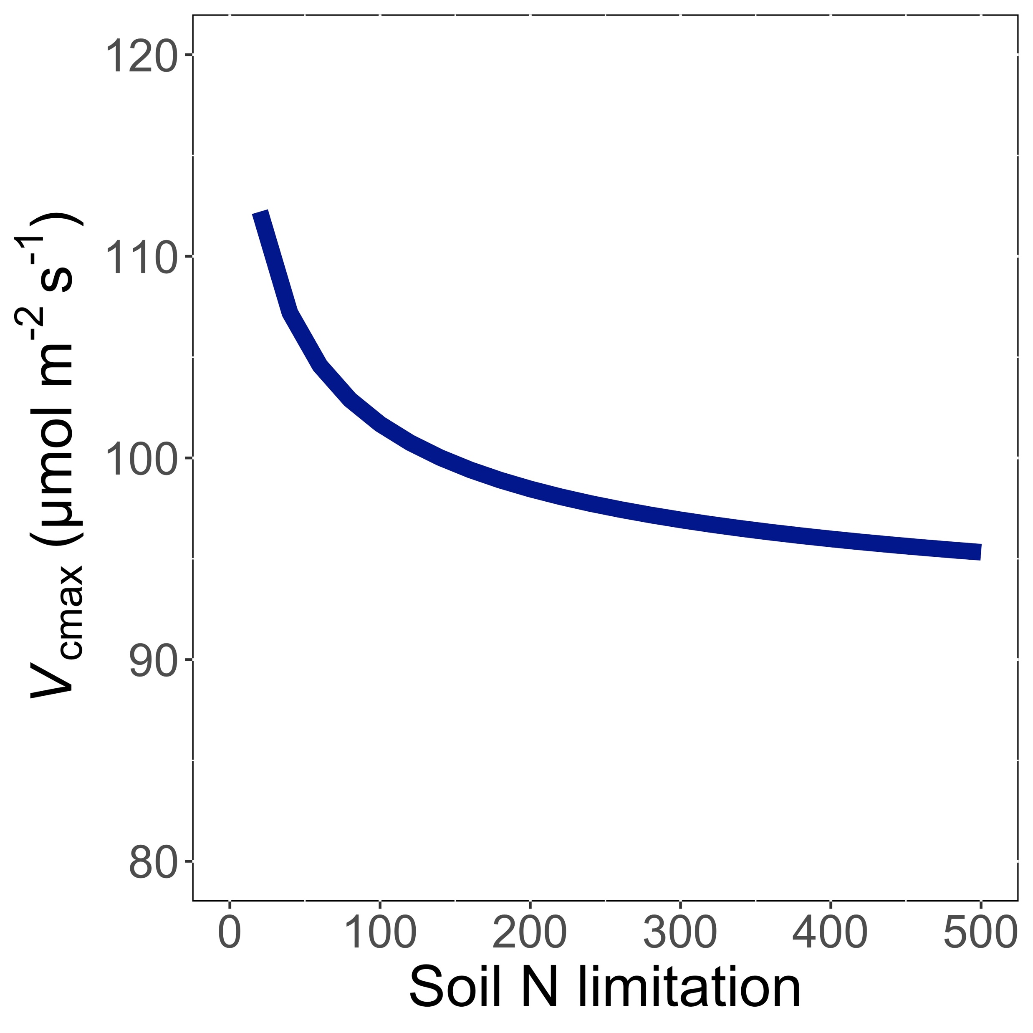
V_{cmax} decreases with soil N limitation because Rubisco requires a lot of N
Smith et al. (2019); Smith and Keenan (2020)

Slide 45
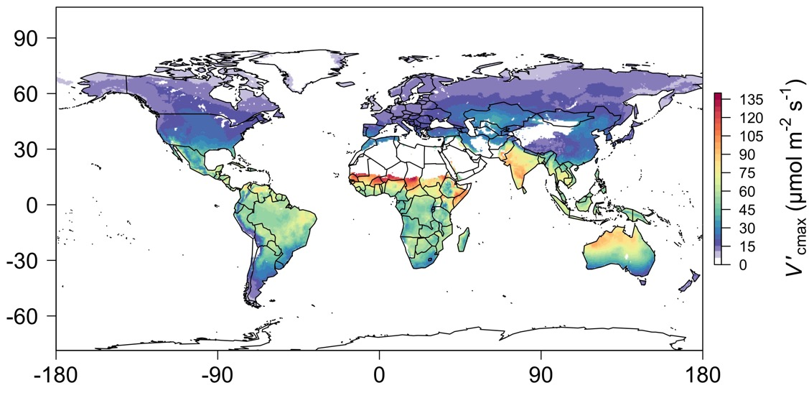
We can predict optimal traits in different environments
Smith et al. (2019)

Slide 46
Ok, great, but now what?

Slide 47
We can use the theory as a null model to explore acclimation mechanisms

Slide 48
Let’s tackle some big questions in plant ecophysiology!

Slide 49
Big questions
Is photosynthesis optimized to the environment?
How do plants acclimate to soil nitrogen?
What does acclimation mean for future terrestrial biogeochemical cycling?
When is C₄ photosynthesis an advantage over C₃ photosynthesis?

Slide 50
Question 1: Is photosynthesis optimized to the environment?

Slide 51
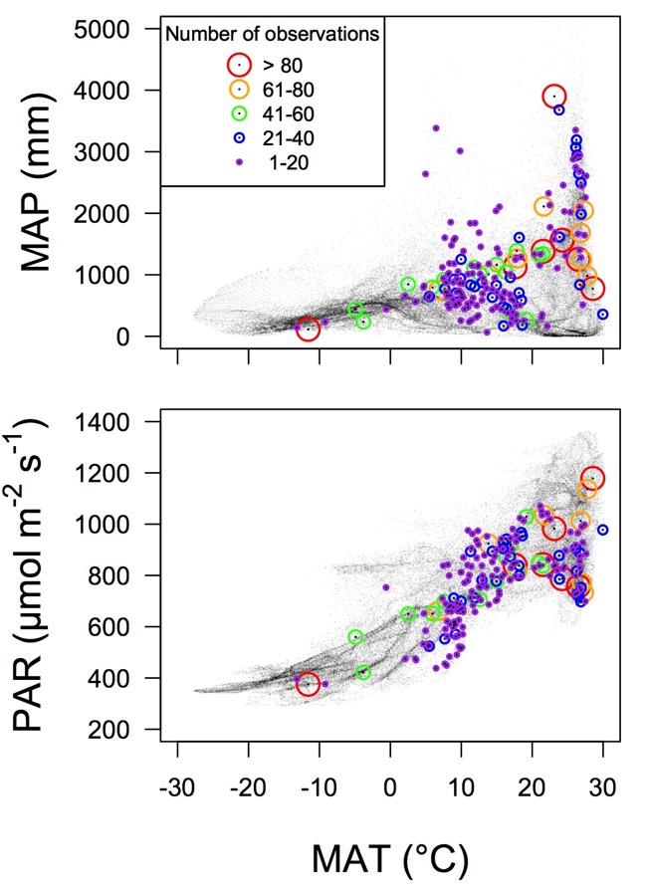
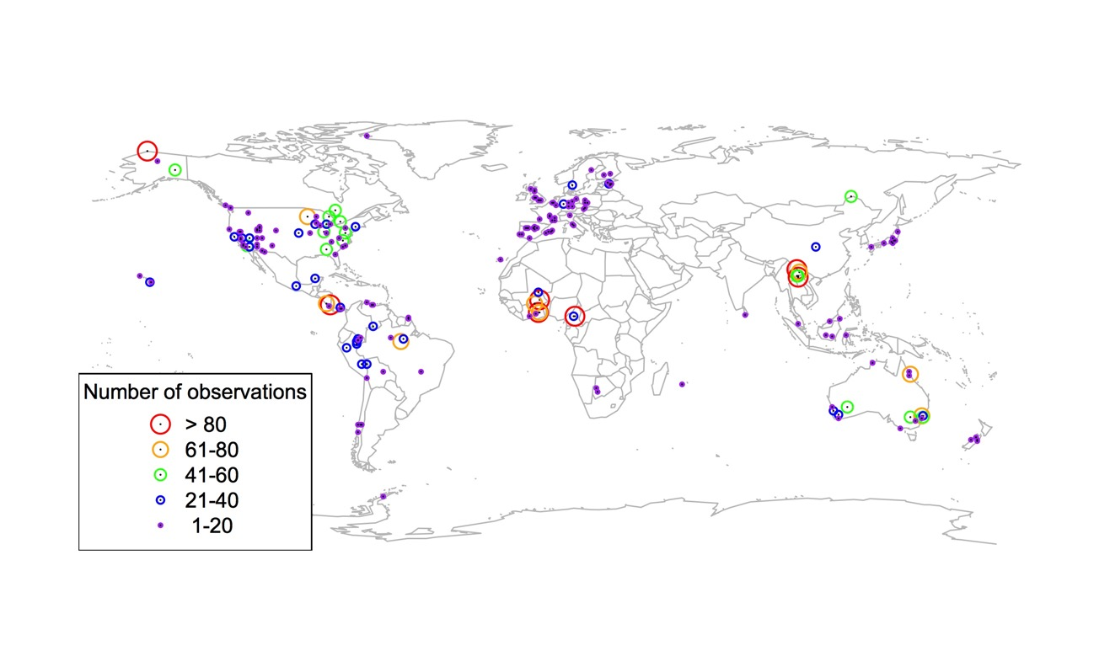
Global V_{cmax} dataset
3,697 measurements
202 sites
> 600 genera
Smith et al. (2019)

Slide 52

Smith et al. (2019)

Slide 53
Optimal V_{cmax} is similar to observed values
Smith et al. (2019)

Slide 54
Question 1: Is photosynthesis optimized to the environment? YES! Photosynthesis acclimates spatially as expected from optimization

Slide 55

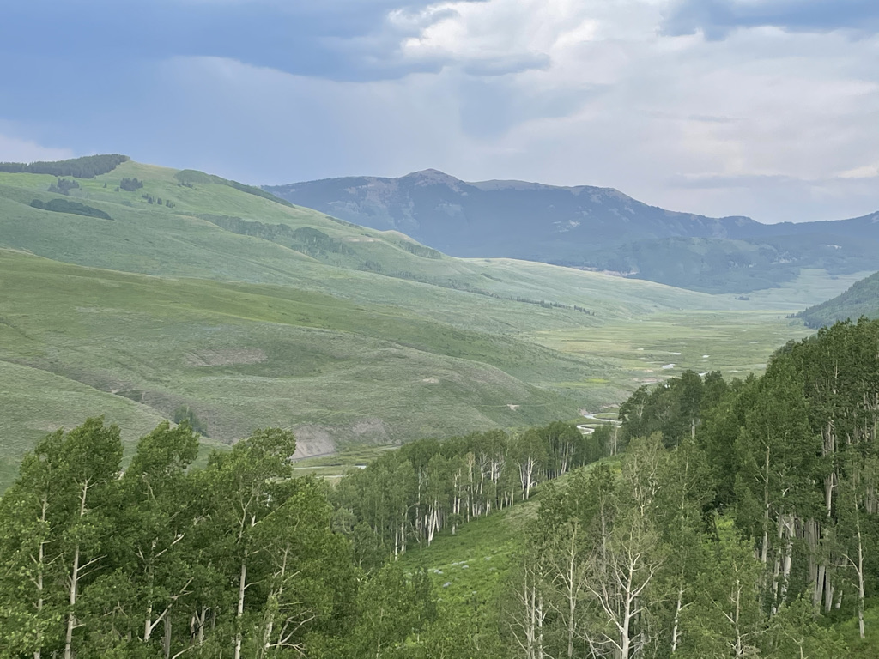
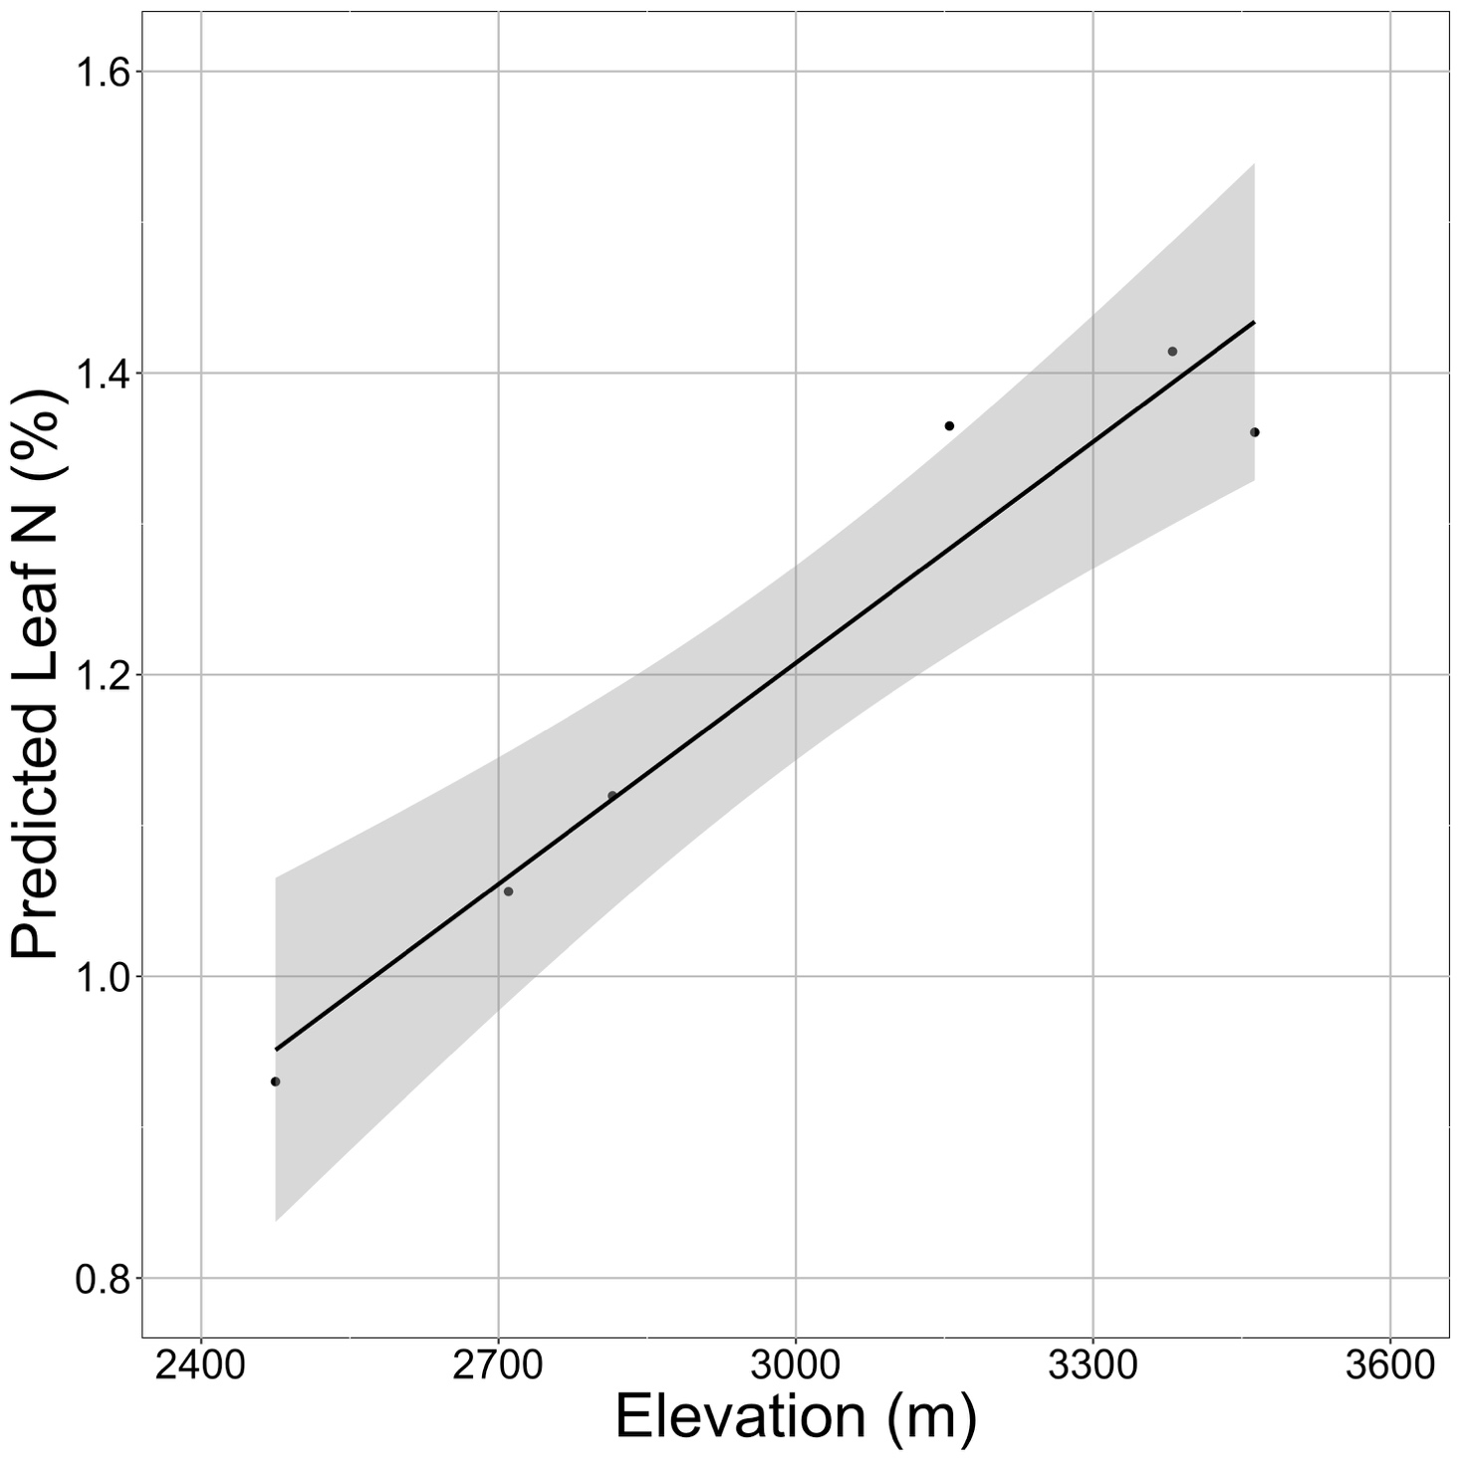
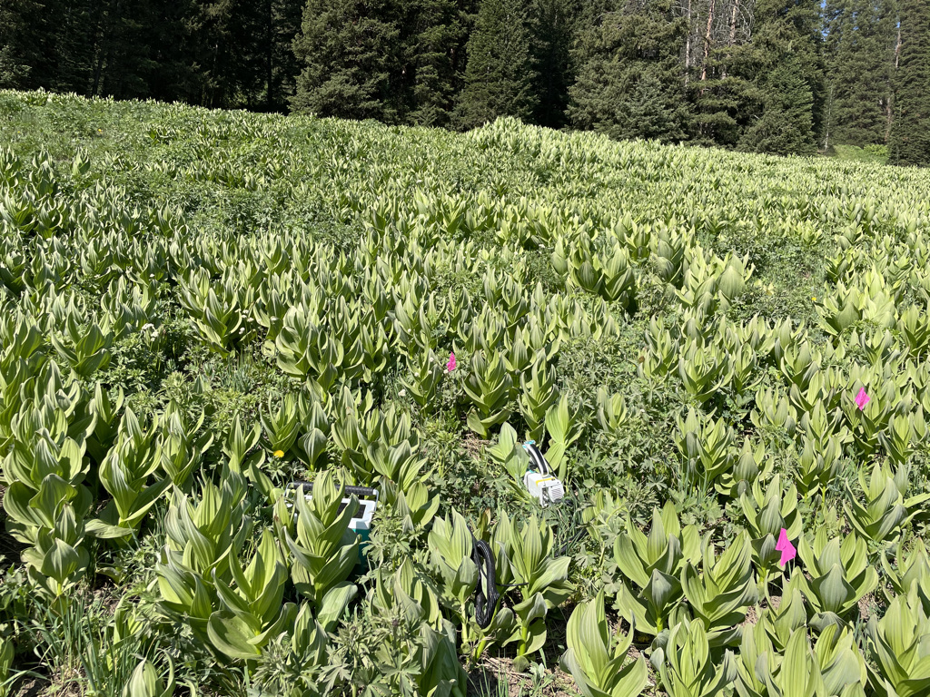

Looking forward: larger scale impacts of acclimation

Slide 56
Question 2: How do plants acclimate to soil nitrogen?

Slide 57
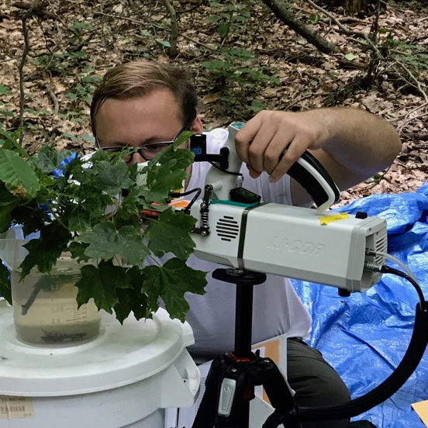
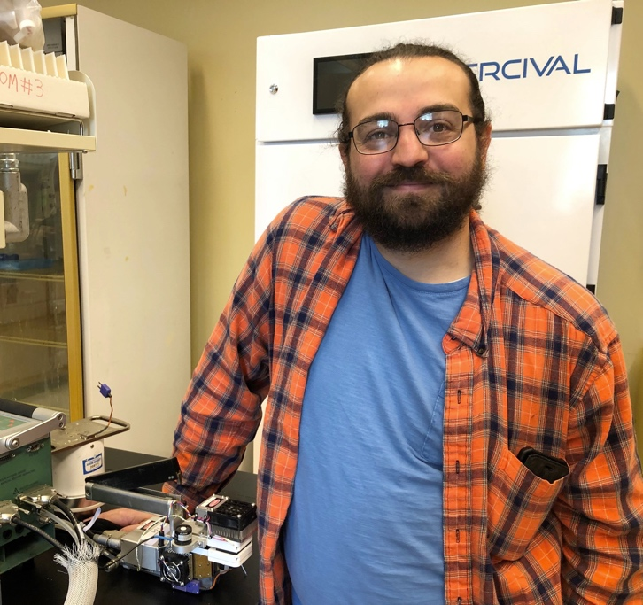

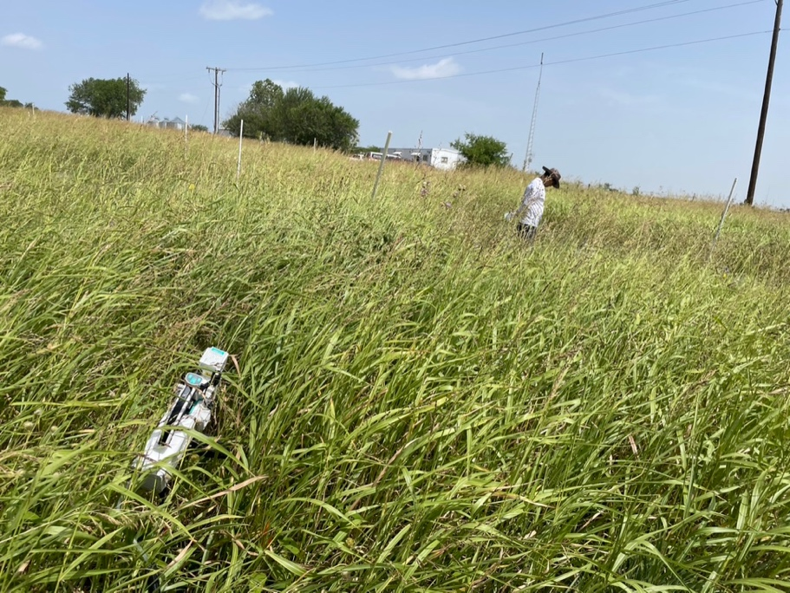
The lab has examined soil nitrogen impacts in many contexts
Observational gradient studies
Paillassa et al. (2020), Perkowski and Smith (in prep)
Greenhouse soil manipulation studies
Perkowski et al. (2021), Waring et al. (in review)
Field soil manipulation studies
Perkowski et al. (in prep), Smith et al. (in prep)

Slide 58
What have we learned?

Slide 59
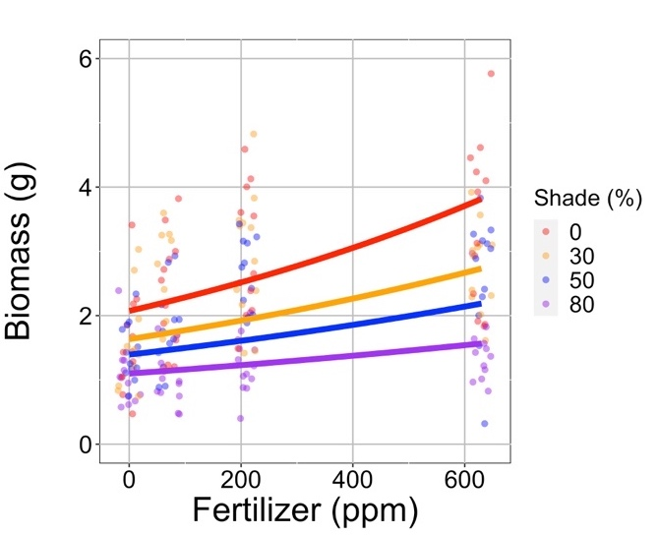
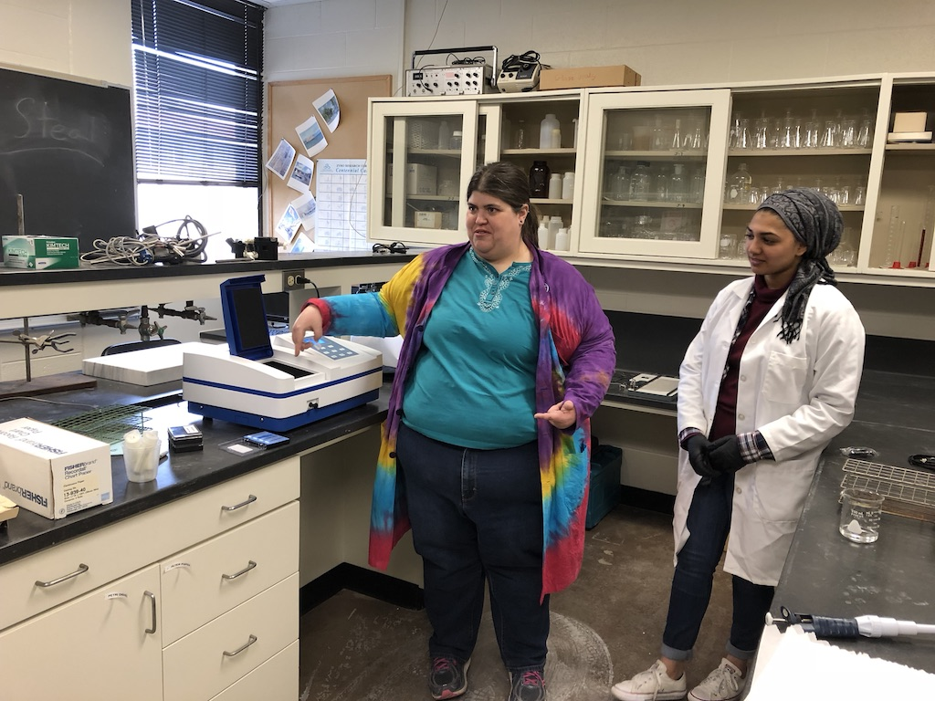
Result 1: Growth increases with increasing soil N
*Consistent across all studies
Waring, Perkowski, and Smith (in review)

Slide 60
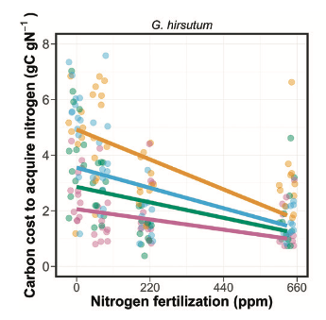

Result 2: C cost to acquire N decreases with increasing soil N
*Consistent across all studies at leaf and plant level
Perkowski et al. (2021)

Slide 61
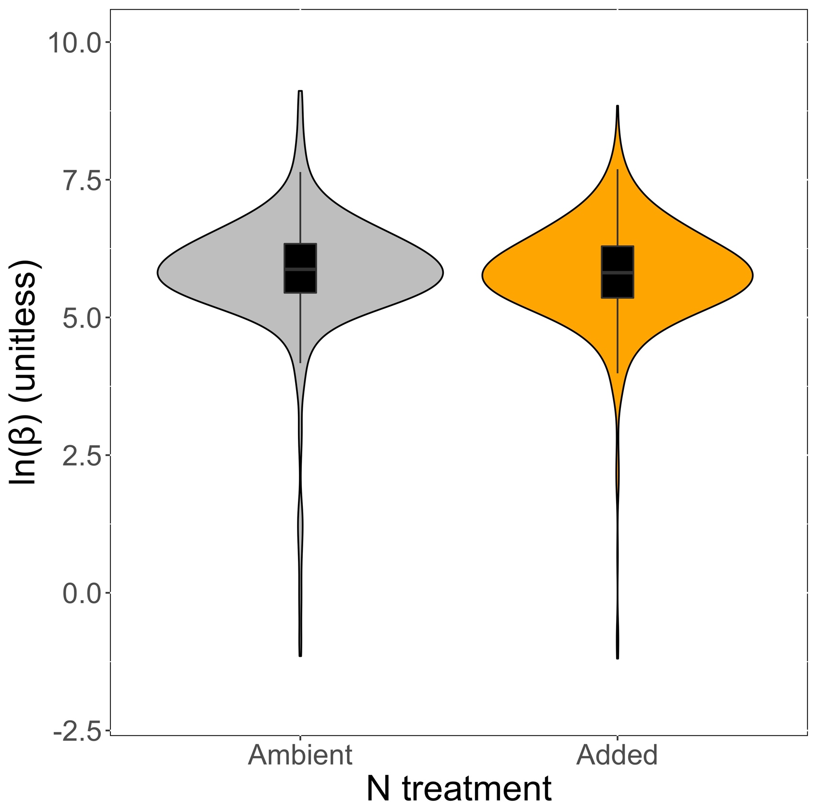
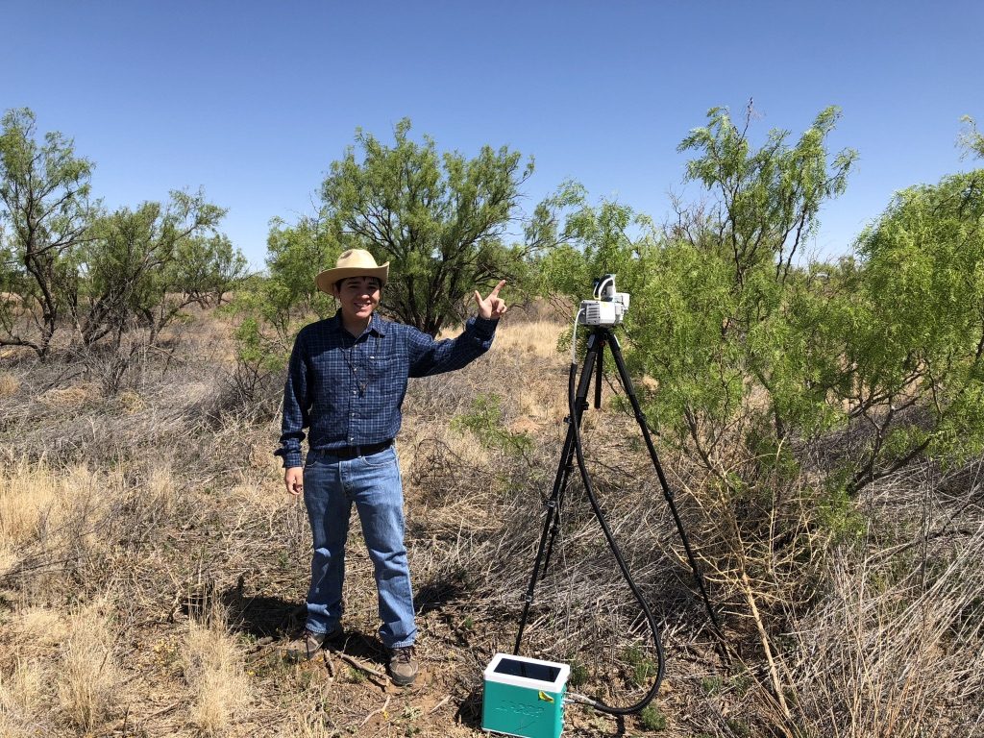
Result 2: C cost to acquire N decreases with increasing soil N
8% reduction
*Consistent across all studies at leaf and plant level
Smith et al. (in prep)

Slide 62
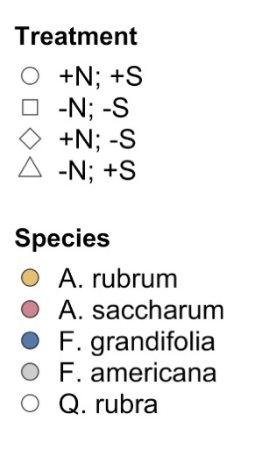
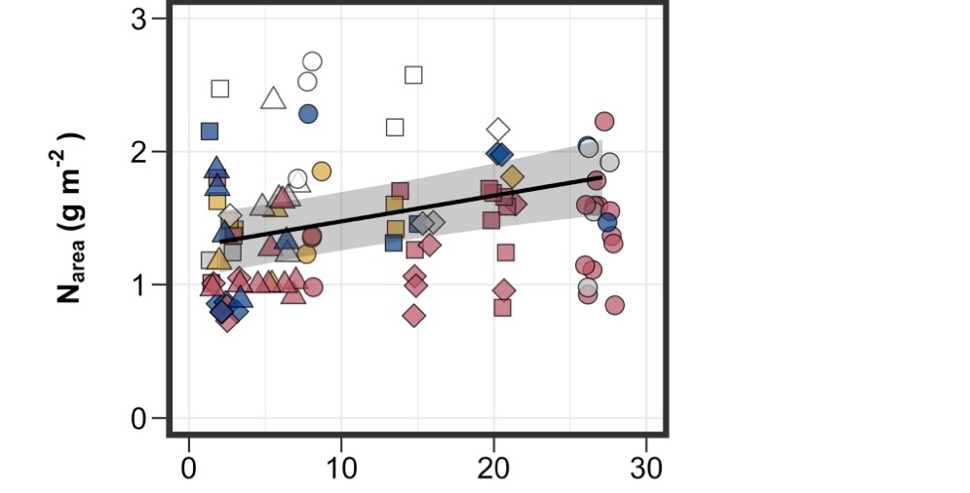
Result 3: Tissue N increases with increasing soil N
*Consistent across all studies
Perkowski et al. (in prep)

Slide 63
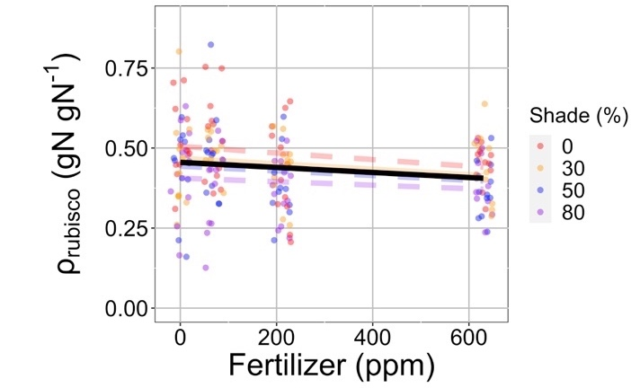
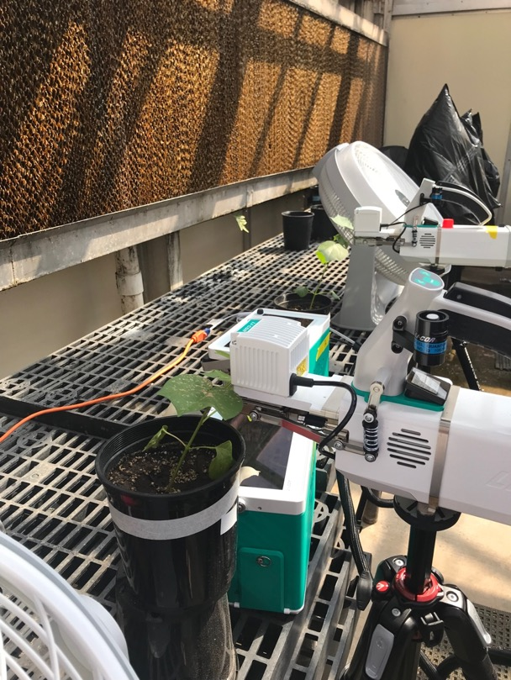
Result 4: Relative leaf N allocation to photosynthesis decreases with increasing soil N
*Consistent across multiple species, metrics, and growth conditions
Waring, Perkowski, and Smith (in review)

Slide 64
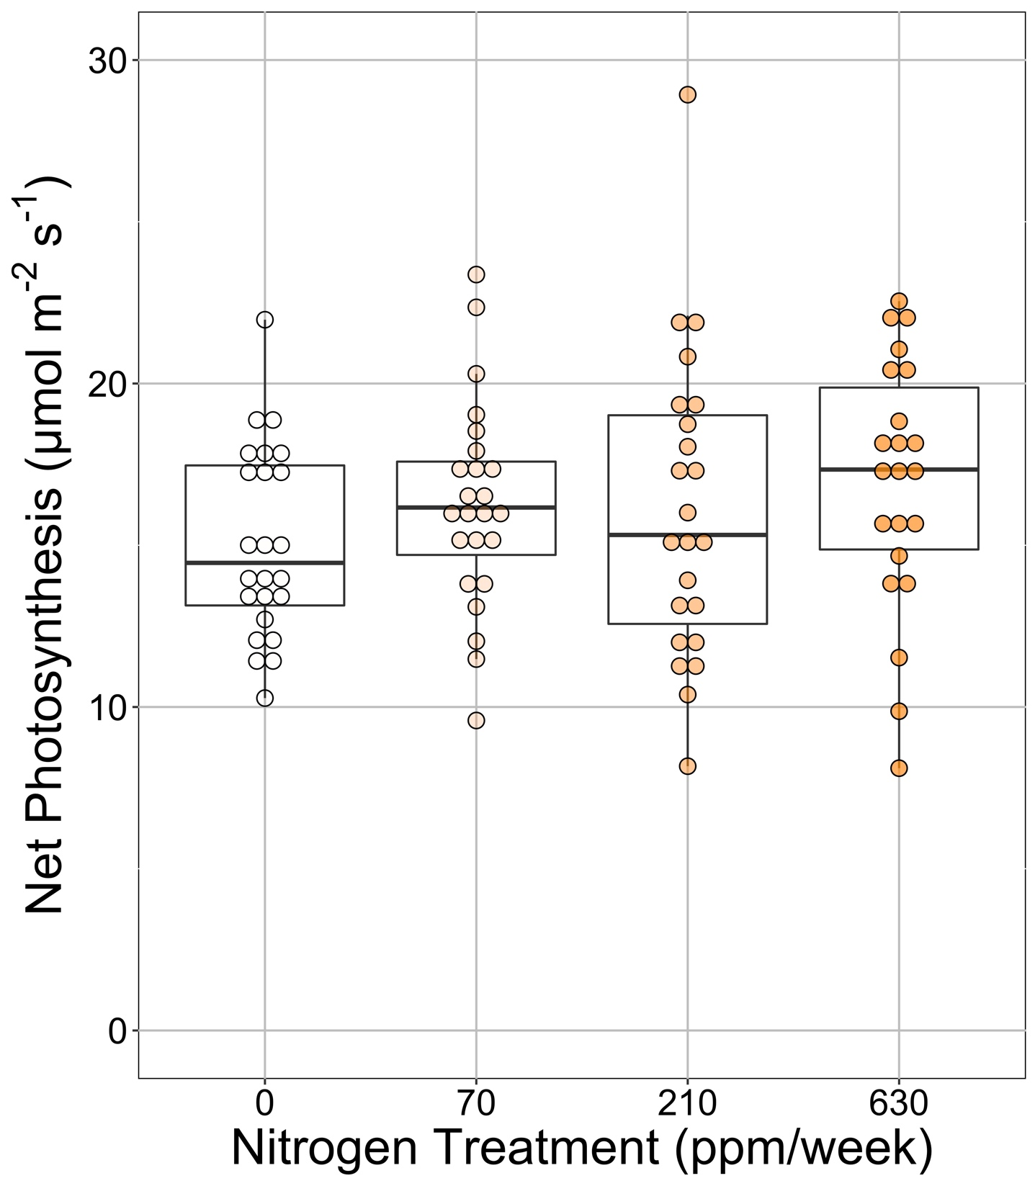
Result 5: Little to no change in per-leaf-area photosynthesis
Waring, Perkowski, and Smith (in review)

Slide 65
Question 2: How do plants acclimate to soil nitrogen? Reduction in N uptake costs results in bigger plants with more leaf N, but little change in per-leaf-area photosynthesis

Slide 66
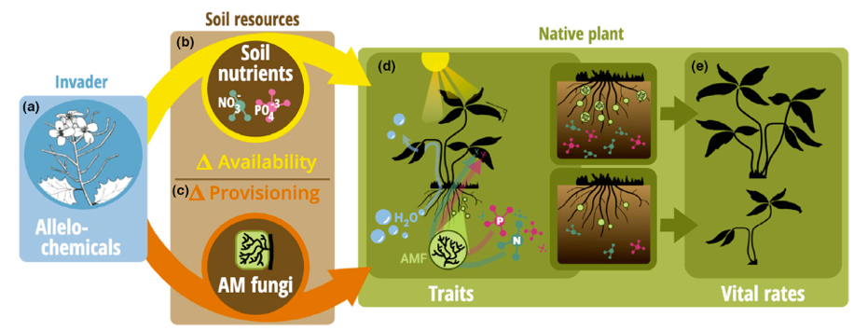
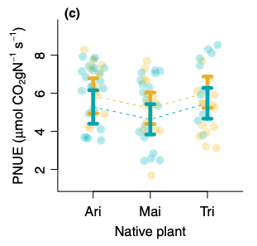

Looking forward: impact of allelopathic invaders on leaf economics
Allelopathic invasion (gold) increased photosynthetic N use efficiency of native plants. This response was predicted by acclimation theory.
Bialic-Murphy et al. (2021)

Slide 67
Question 3: What does acclimation mean for future terrestrial biogeochemical cycling?

Slide 68

Expected future responses
V_{cmax} decreases with CO₂ because of greater CO₂ in the leaf and less photorespiration
Smith et al. (2019)

Slide 69
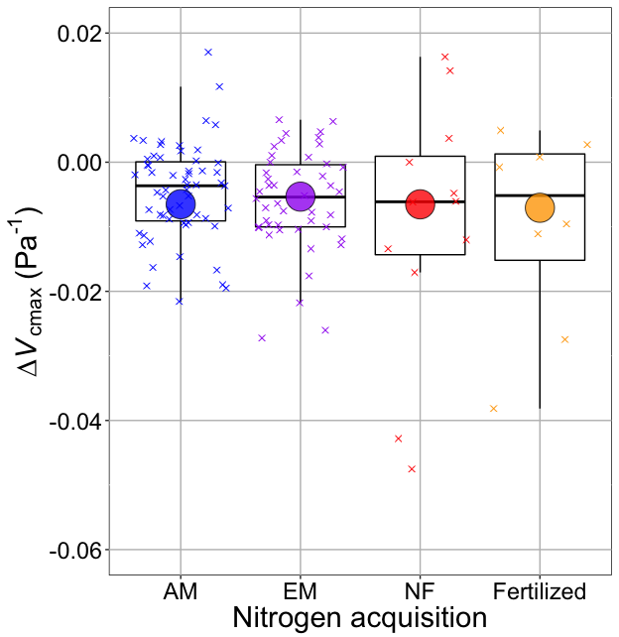
Smith and Keenan (2020)

Slide 70
V_{cmax} changes with CO₂ in ways expected from optimization
Boxes = data = -0.0063 Pa⁻¹
Circles = predicted = -0.0066 Pa⁻¹
Smith and Keenan (2020)

Slide 71
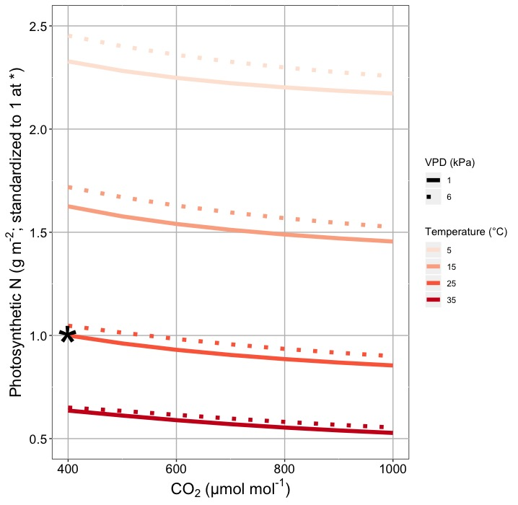
This generally suggests lower nitrogen demand under future conditions
Smith and Keenan (2020)

Slide 72

Let’s run a model out into the future!

Slide 73
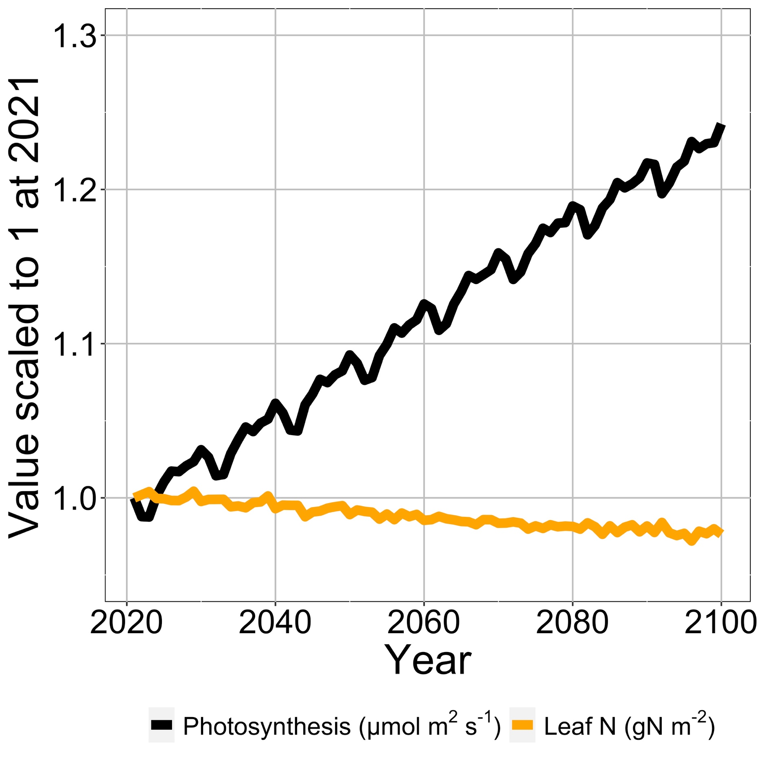
Photosynthesis increases with elevated CO₂ at lower leaf N
Smith et al. (in prep)

Slide 74
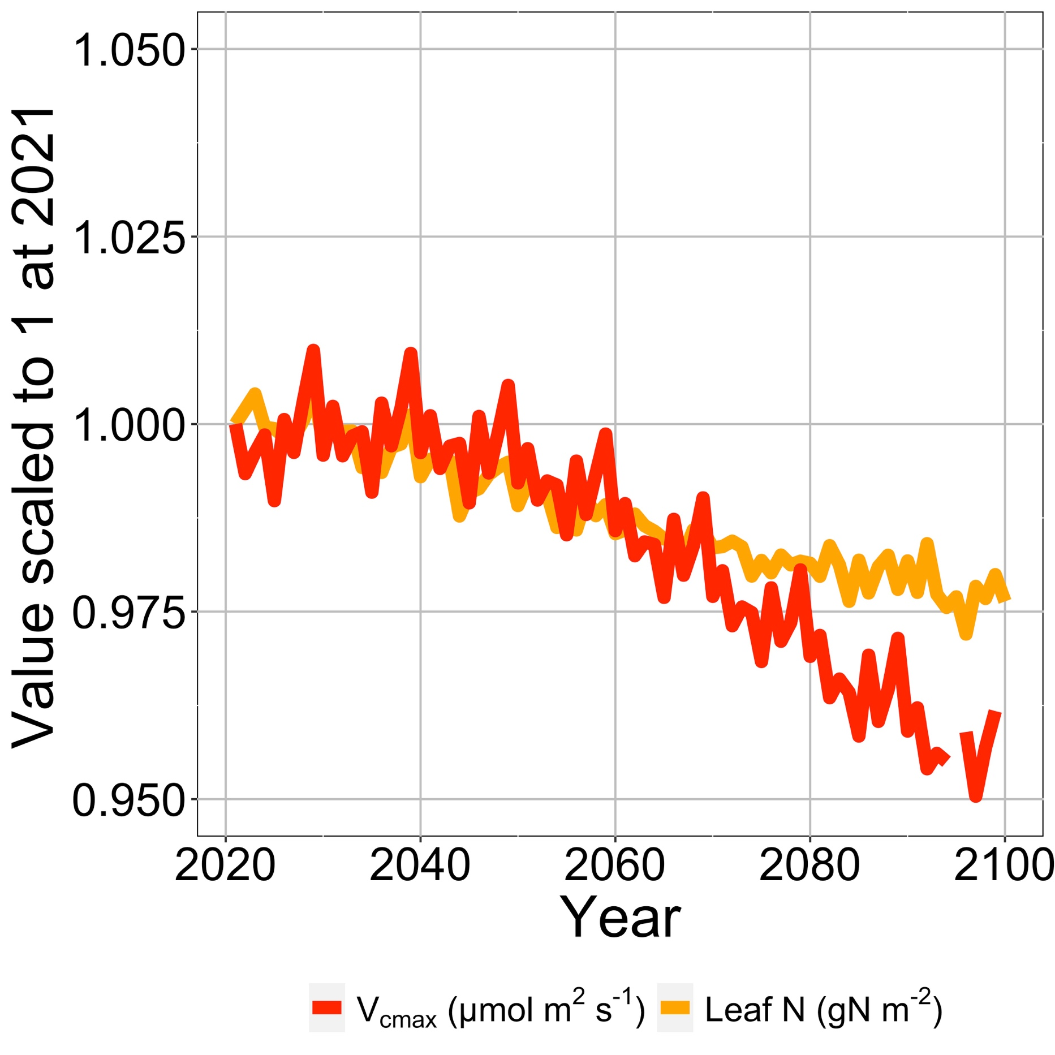
Leaf N reduction is due to a reduction in photosynthetic capacity
Smith et al. (in prep)

Slide 75
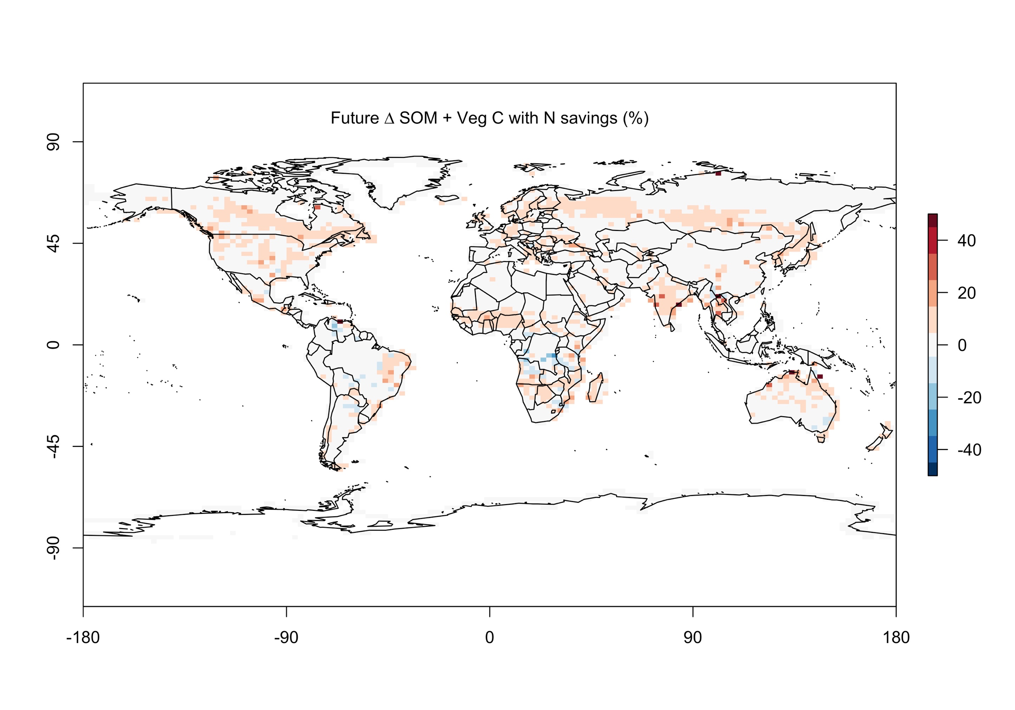
Leaf N savings increases long-term ecosystem carbon stocks
Smith et al. (in prep)

Slide 76
Need to rethink nutrient limitation in models?
“No limitation” simulation
“Nutrient limitation” simulations
Weider et al. (2015)

Slide 77
Question 3: What does acclimation mean for future terrestrial biogeochemical cycling? Photosynthesis will increase and per-leaf-area nutrient use will decrease

Slide 78
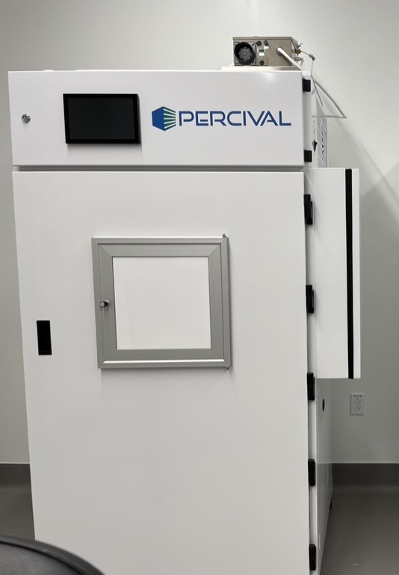
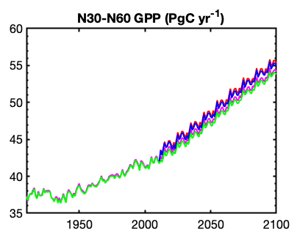

Looking forward: role of acclimation on future ecosystem feedbacks to global change
Coupled
model-data experiments

Slide 79
Question 4: When is C₄ photosynthesis an advantage over C₃ photosynthesis?

Slide 80
C₃ versus C₄ optimization

Slide 81
C₄ versus C₃ optimization
C₄ photosynthesis has…
Little photorespiration
An additional limitation (PEP carboxylation)

Slide 82
C₄ versus C₃ optimization
C₄ photosynthesis has…
Little photorespiration
An additional limitation (PEP carboxylation)

Slide 83

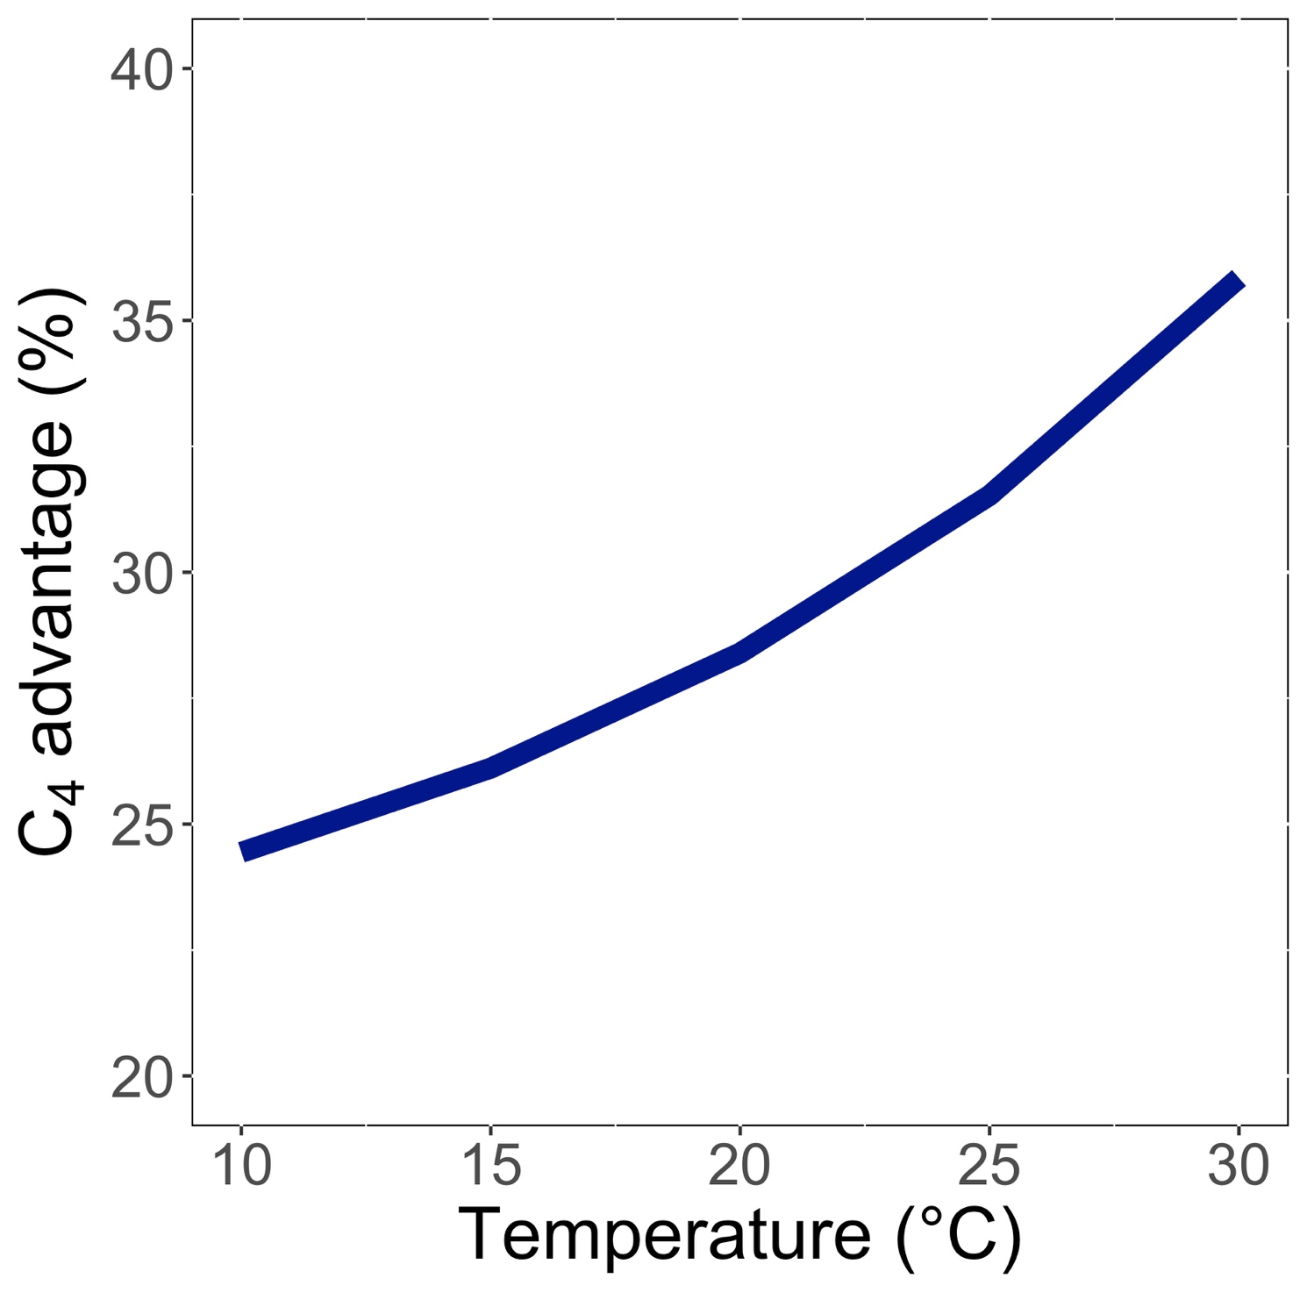
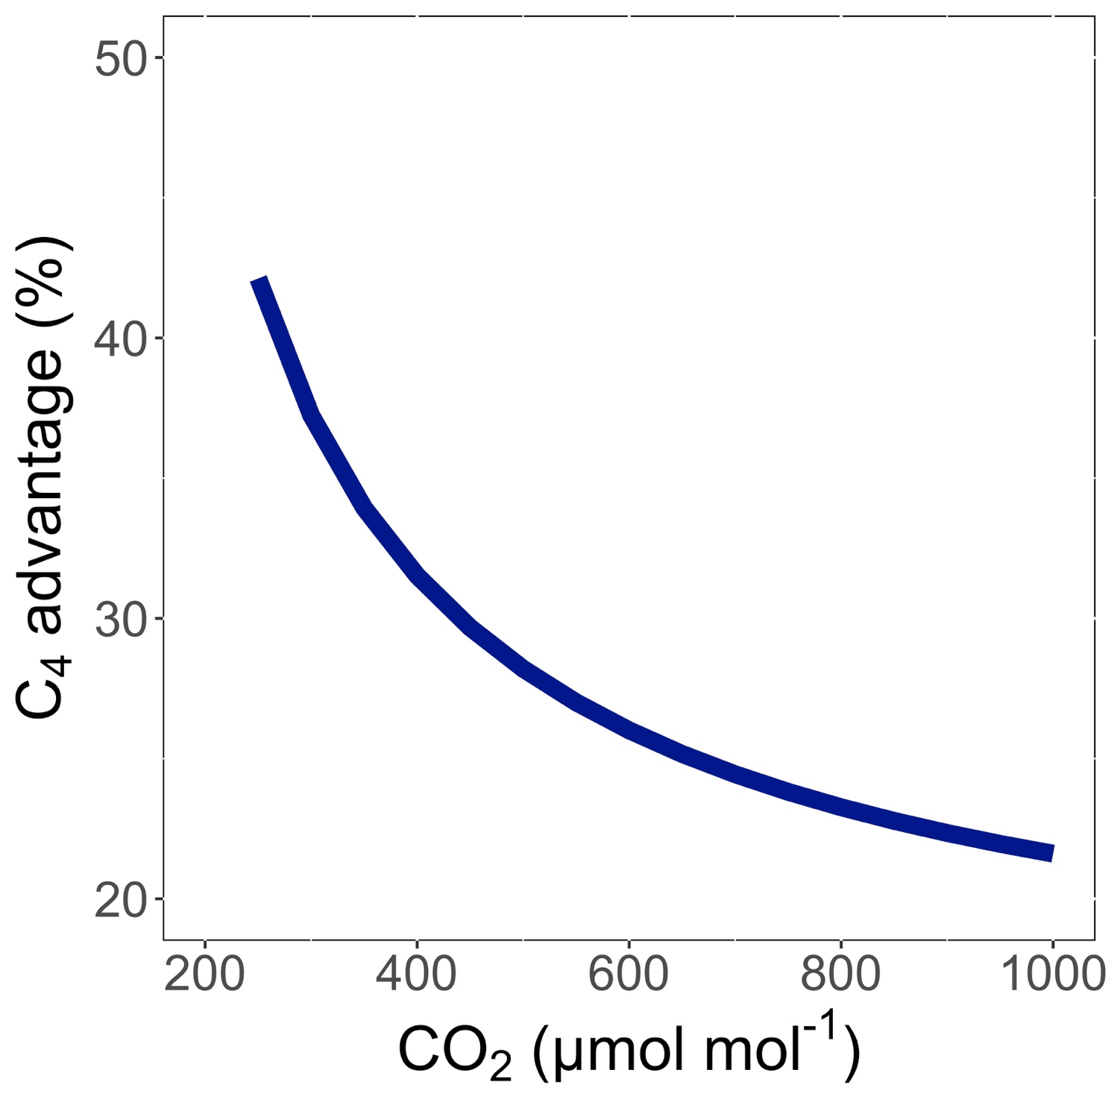
Relative advantage of C₄ physiology
Scott and Smith (2022)

Slide 84
Relative advantage of C₄ physiology
Scott and Smith (2022)

Slide 85
Relative advantage of C₄ physiology
Scott and Smith (2022)

Slide 86
The model seems to work!
Benefit of C₄ photosynthesis (%)
C₄ vegetation (%)
Scott and Smith (2022)

Slide 87
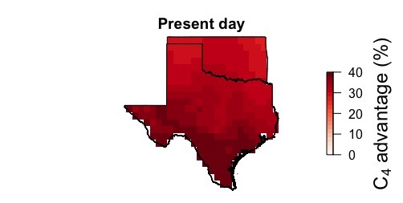
Ansley et al. (in review)

Slide 88
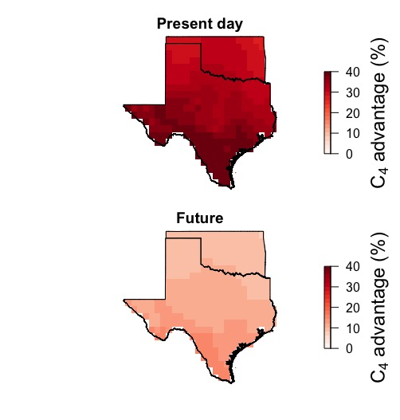
Relative advantage of C₄ physiology may decrease in the future in the Southern Great Plains
Ansley et al. (in review)

Slide 89
Question 4: When is C₄ photosynthesis an advantage over C₃ photosynthesis? C₄ is better in hot, dry, low CO₂ environments

Slide 90



Looking forward: model-data comparisons for C₄ plants

Slide 91
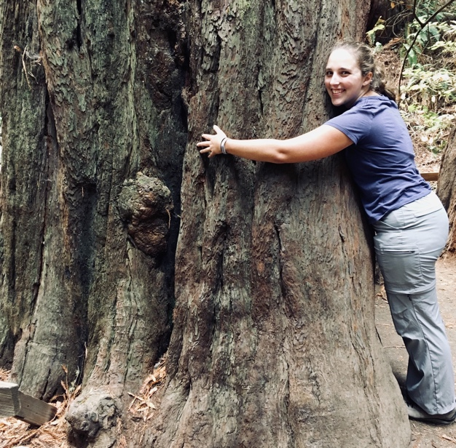
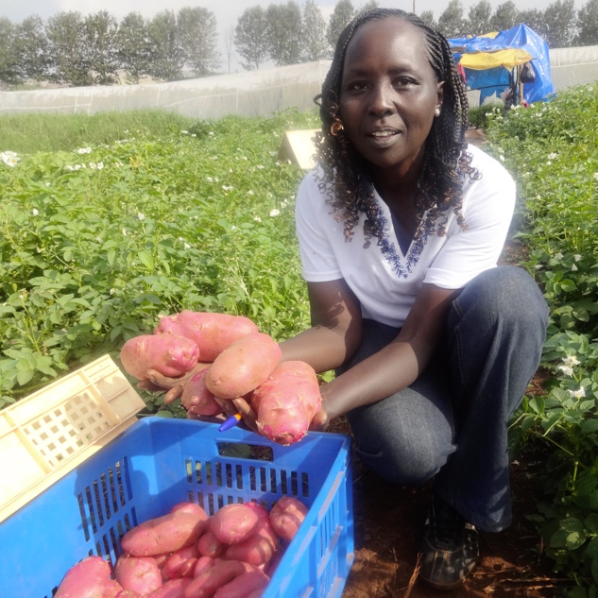
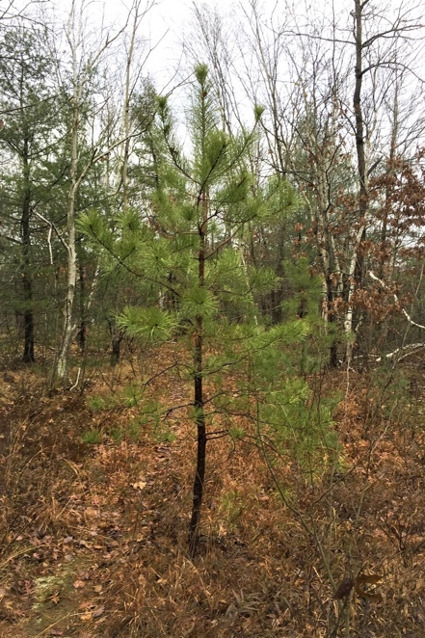


Other activities of note
Role of agricultural land management in determining plant- and ecosystem-scale processes
Bell and Smith (2021); McNellis et al. (in review); Borus et al. (in prep)
Southern pine beetle impacts on pitch pine
Licht and Smith (2020); Licht et al. (in review); Licht et al. (in prep)
5th National Climate Assessment for Southern Great Plains
McPherson et al. (in prep)
Course-based undergrad research experiences

Slide 92
Conclusions

Slide 93
Conclusions
Plants aren’t dumb!
Assuming plants don’t dynamically respond to their environment can lead to poor understanding of ecosystem functioning
Dumb plants

Slide 94



Conclusions
Quantified physiological theory can:
Improve mechanistic understanding of physiological processes that underlie higher level responses
Produce more reliable future projections
f(x)
f(x)

Slide 95
And ultimately lead to a better understanding of how future ecosystem services will be impacts by global change

Slide 96








Acknowledgements
Current lab members
Brad Posch (postdoc)
Evan Perkowski (PhD)
Zinny Ezekannagha (PhD)
Snehanjana Chatterjee (PhD)
Eve Gray (MS)
Monika Kelley (MS)
Isabella Beltran (MS)
Former lab members
Jeff Chieppa (postdoc; now working in industry)
Lizz Waring (postdoc; now Asst. Prof at Northeastern State U)
Risa McNellis (MS; now at Plum Island LTER)
Helen Scott (MS; now in industry and PhD student at BU)
Abigail Bell (BS; now in industry)
Too many undergrads to list!
Collaborators, colleagues, and friends at TTU
Collaborators around the world
Funding
NSF
USDA
NPS
USGS
Schmidt Futures
Texas EcoLab

Slide 97

Presentation available at:
www.github.com/SmithEcophysLab/seminar/2022_ttu
Thanks!

